Slide 1

Influence of volcanic eruptions on the bi-decadal variability in the North Atlantic
Didier Swingedouw, Pablo Ortega, Juliette Mignot, Eric Guilyardi, Valérie Masson-Delmotte, Paul Butler, Myriam Khodri, Roland Séférian

Slide 2
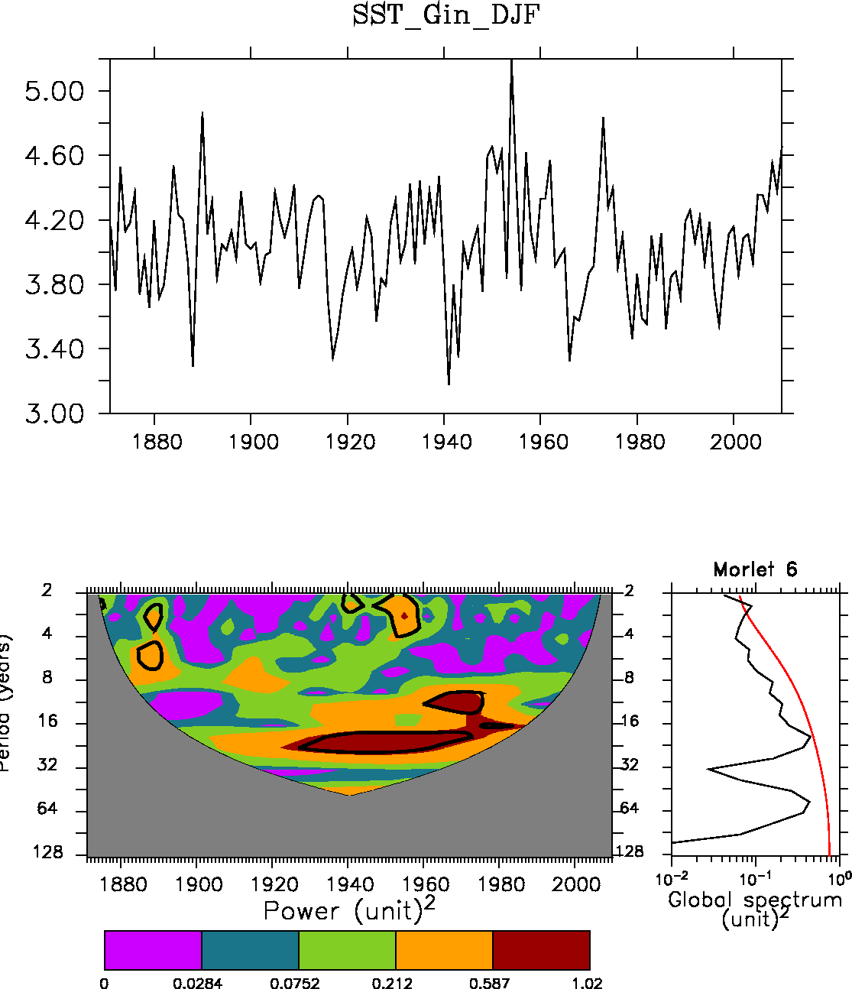
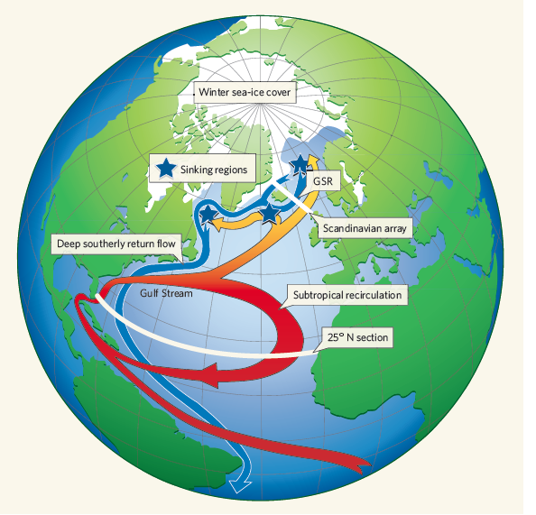
A 20-yr cycle in the North Atlantic?
DJF SST in the GIN Seas (HadISST)
Swingedouw et al.,2013.
Quadfasel
2005

Slide 3
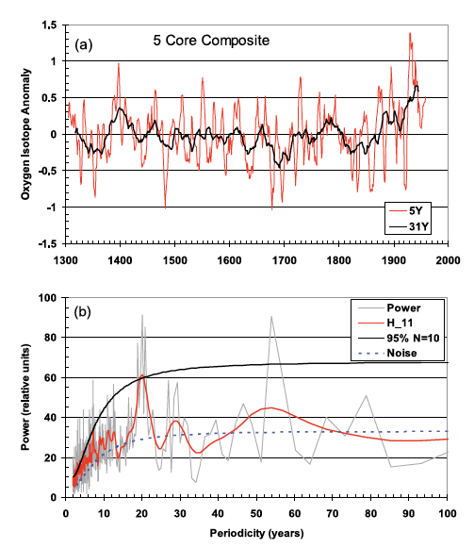
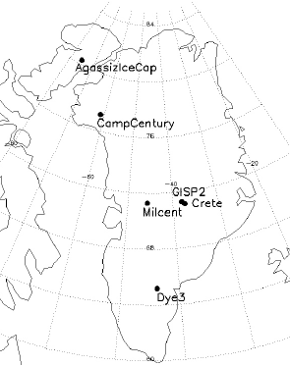
A 20-yr cycle in the North Atlantic?
Quadfasel
2005
Chylek et al. 2011

Slide 4
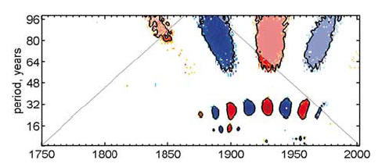
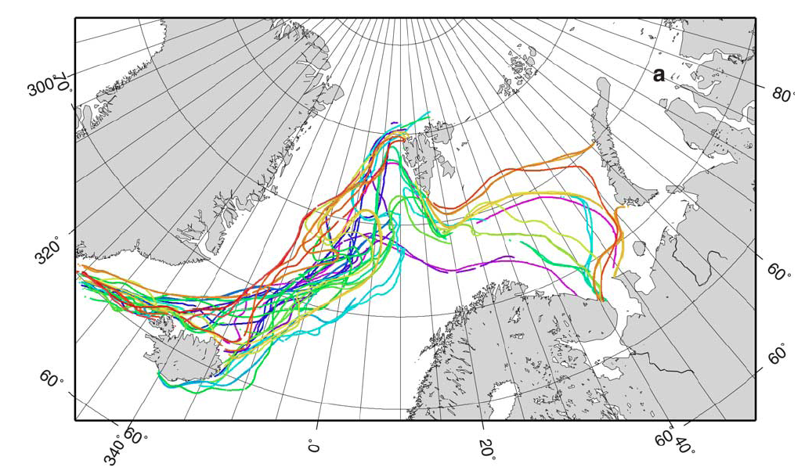
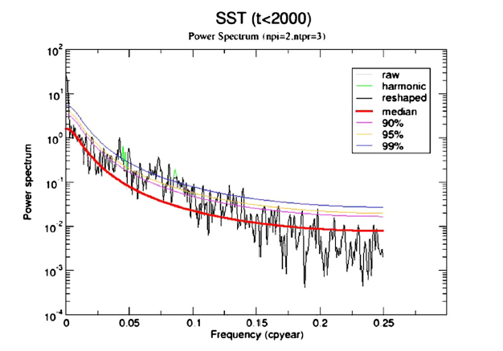
A 20-yr cycle in the North Atlantic?
April sea ice edge in the Nordic Seas
Divine et al. 2006
2000-yr of Alkenone SST
Quadfasel
2005
Found also in different climate models
Sicre et al. 2008
Notes:
Divine: historical data from ship logbook and diaries

Slide 5
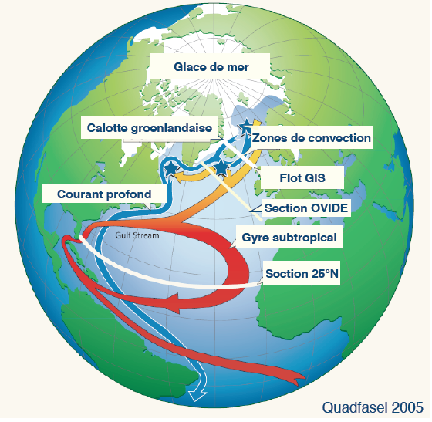

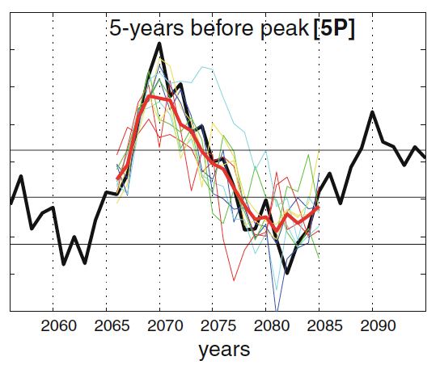
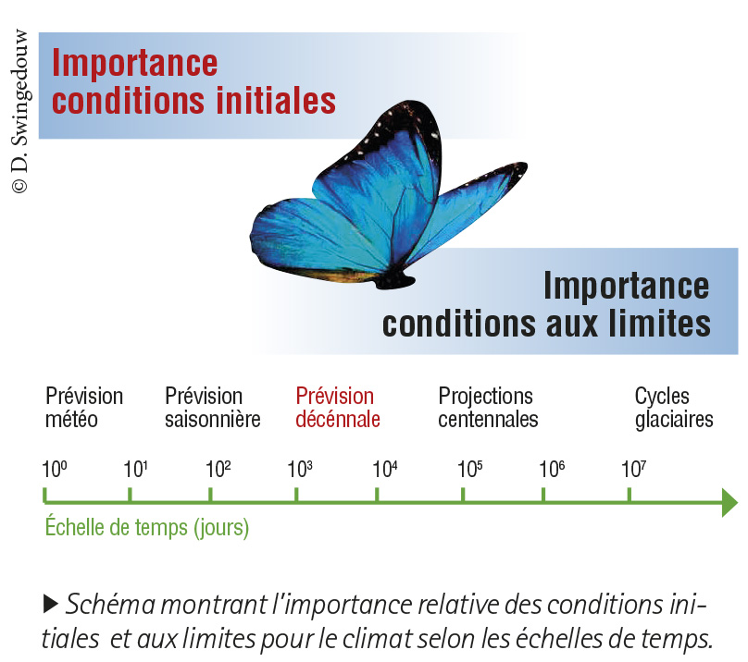
Decadal prediction
10⁶ m³/s
AMOC within IPSL-CM5
Années
Persechino et al. (Clim. Dyn., 2013)

Slide 6

A simple way to initialise a coupled model
Newtonian restoring in SST
Modèle AOGCM
Input (Initial conditions)
Output (climatic variables)
External Forcing (CO2, volcanoes…)

Slide 7
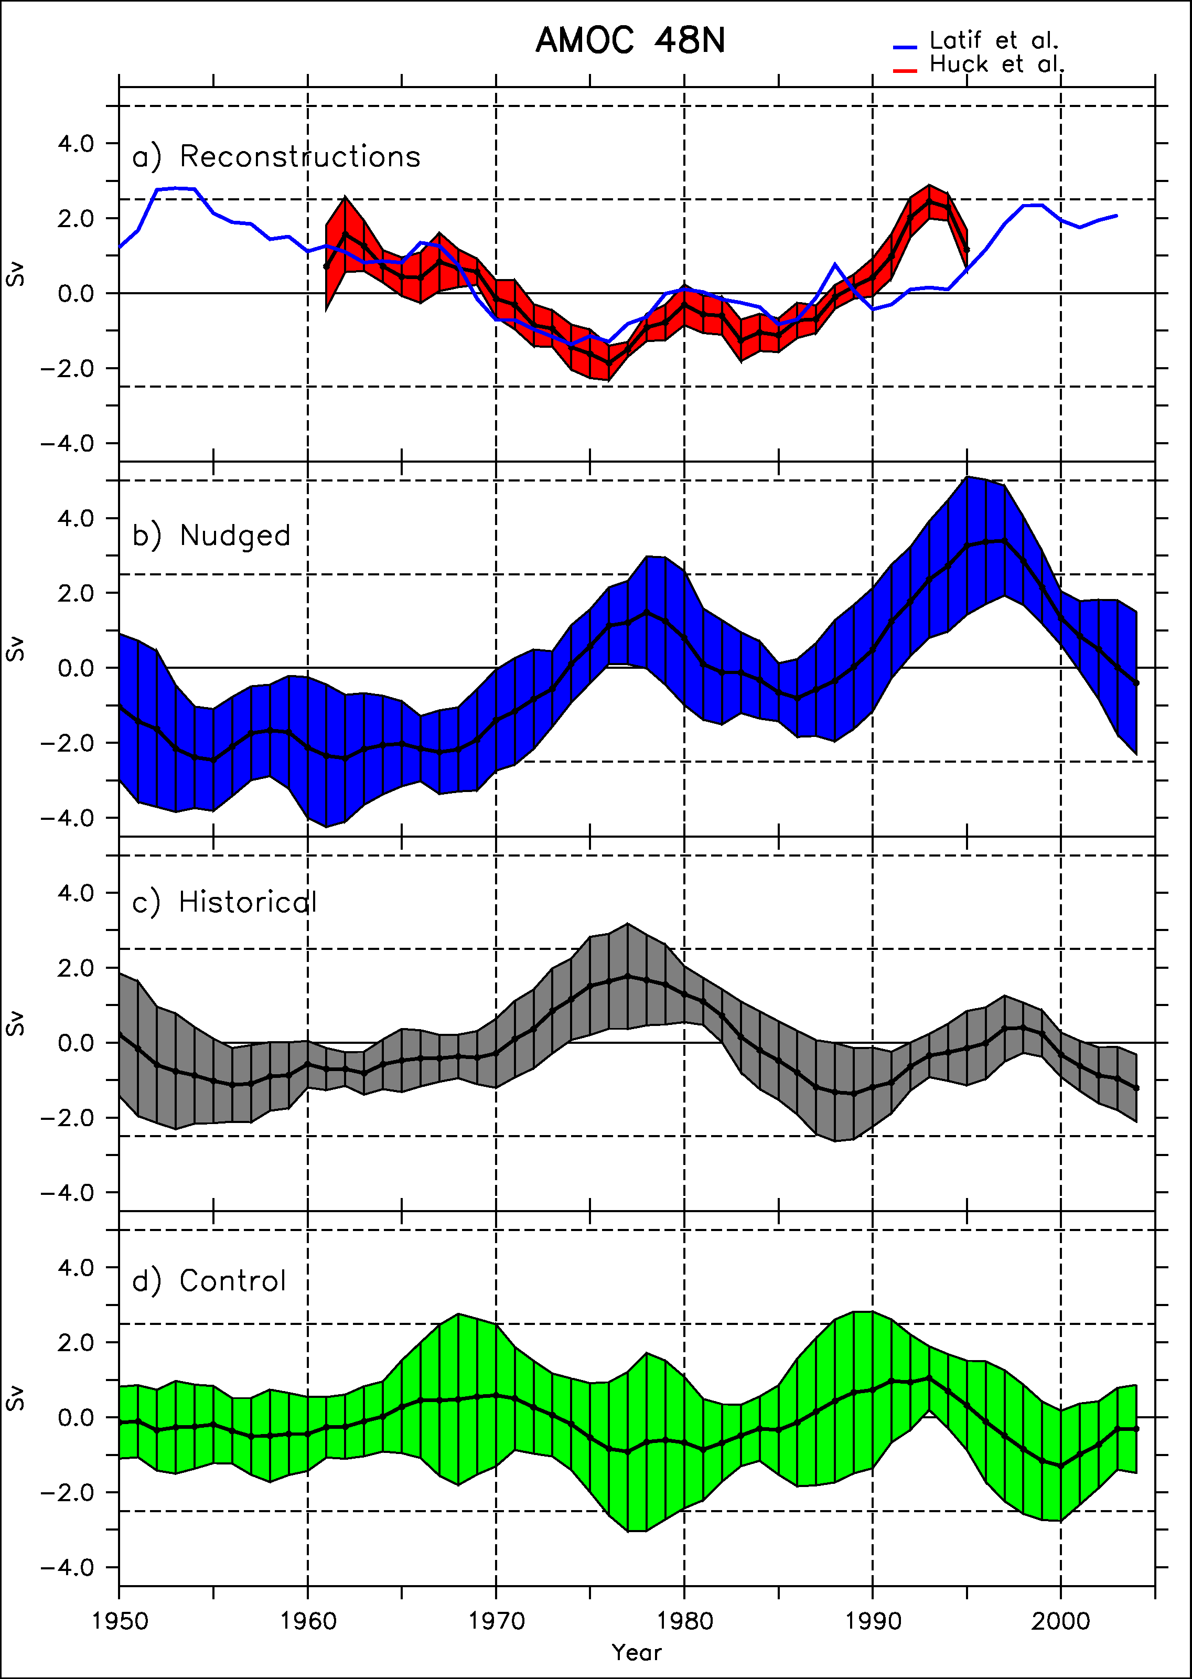
Initialisation of the Atlantic overturning
Reconstructions
Obs. (Huck et
IPSLCM5A-LR simulations nudged or free (with observed external forcings)
Two reconstructions of the Atlantic overturning (AMOC)
Agreement between nudged and reconstructions
Synchronisation also in the historical simulations
Nudged with SST
15 yrs
Historical
Control
Swingedouw et al., Clim. Dyn. 2013
1963

Slide 8
20-yr cycle in IPSL-CM5A-LR
Sea ice cover -,
SLP-
negative delayed feeedback
EGC +
10
yrs
3yrs
5yrs
T,’ S’ +
convection +
2yrs
9yrs
AMOC +
Escudier et al. Clim. Dyn. 2013
Notes:
Virer ?

Slide 9
20-yr cycle in IPSL-CM5A-LR
Sea ice cover -,
SLP-
negative delayed feeedback
EGC +
10
yrs
3yrs
5yrs
T,’ S’ +
convection +
2yrs
Mt Agung eruption
9yrs
AMOC +
Escudier et al. Clim. Dyn. 2013

Slide 10
Is it real?
Model dependent? (Zanchettin et al. 2012)
Need for other lines of evidences (observations!)
AMOC response around 15 years after the eruption is the key assumption that needs to be tested!

Slide 11
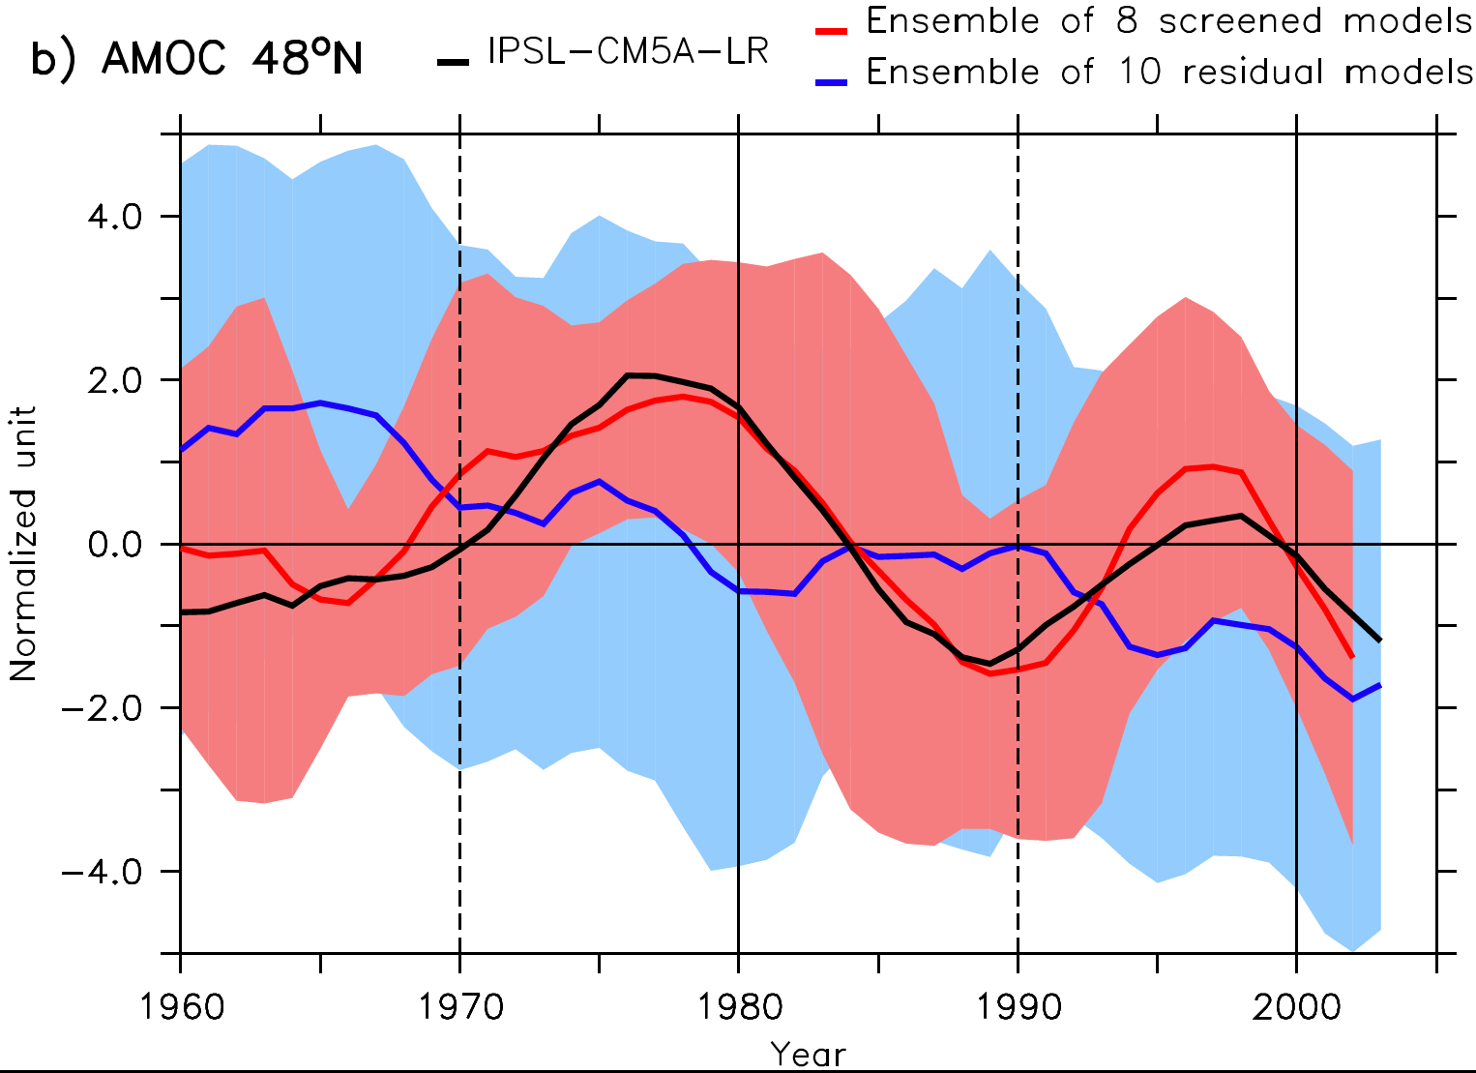
CMIP5 multi-model confirmation?
Ensemble mean of 8 models from CMIP5 with peak variability in the frequency band 10-30 yrs
Resembles IPSLCM5A ensemble mean of 5 members (r=0.97)
Not the case for the others who have a larger spread and mainly shows a decreasing trend in their ensemble mean
Swingedouw et al., Nature Com.. 2015

Slide 12
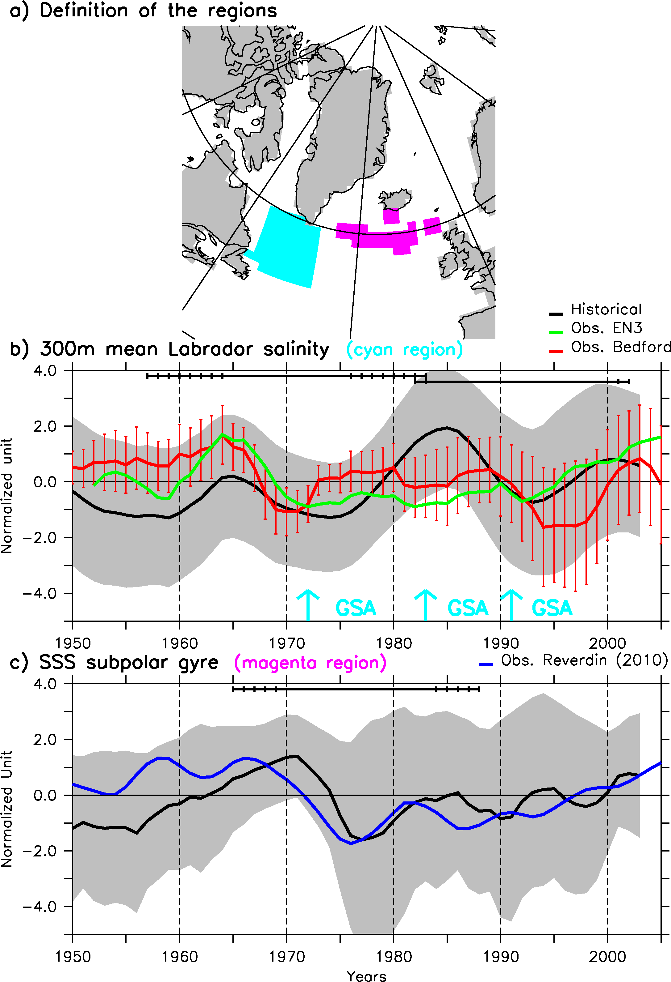
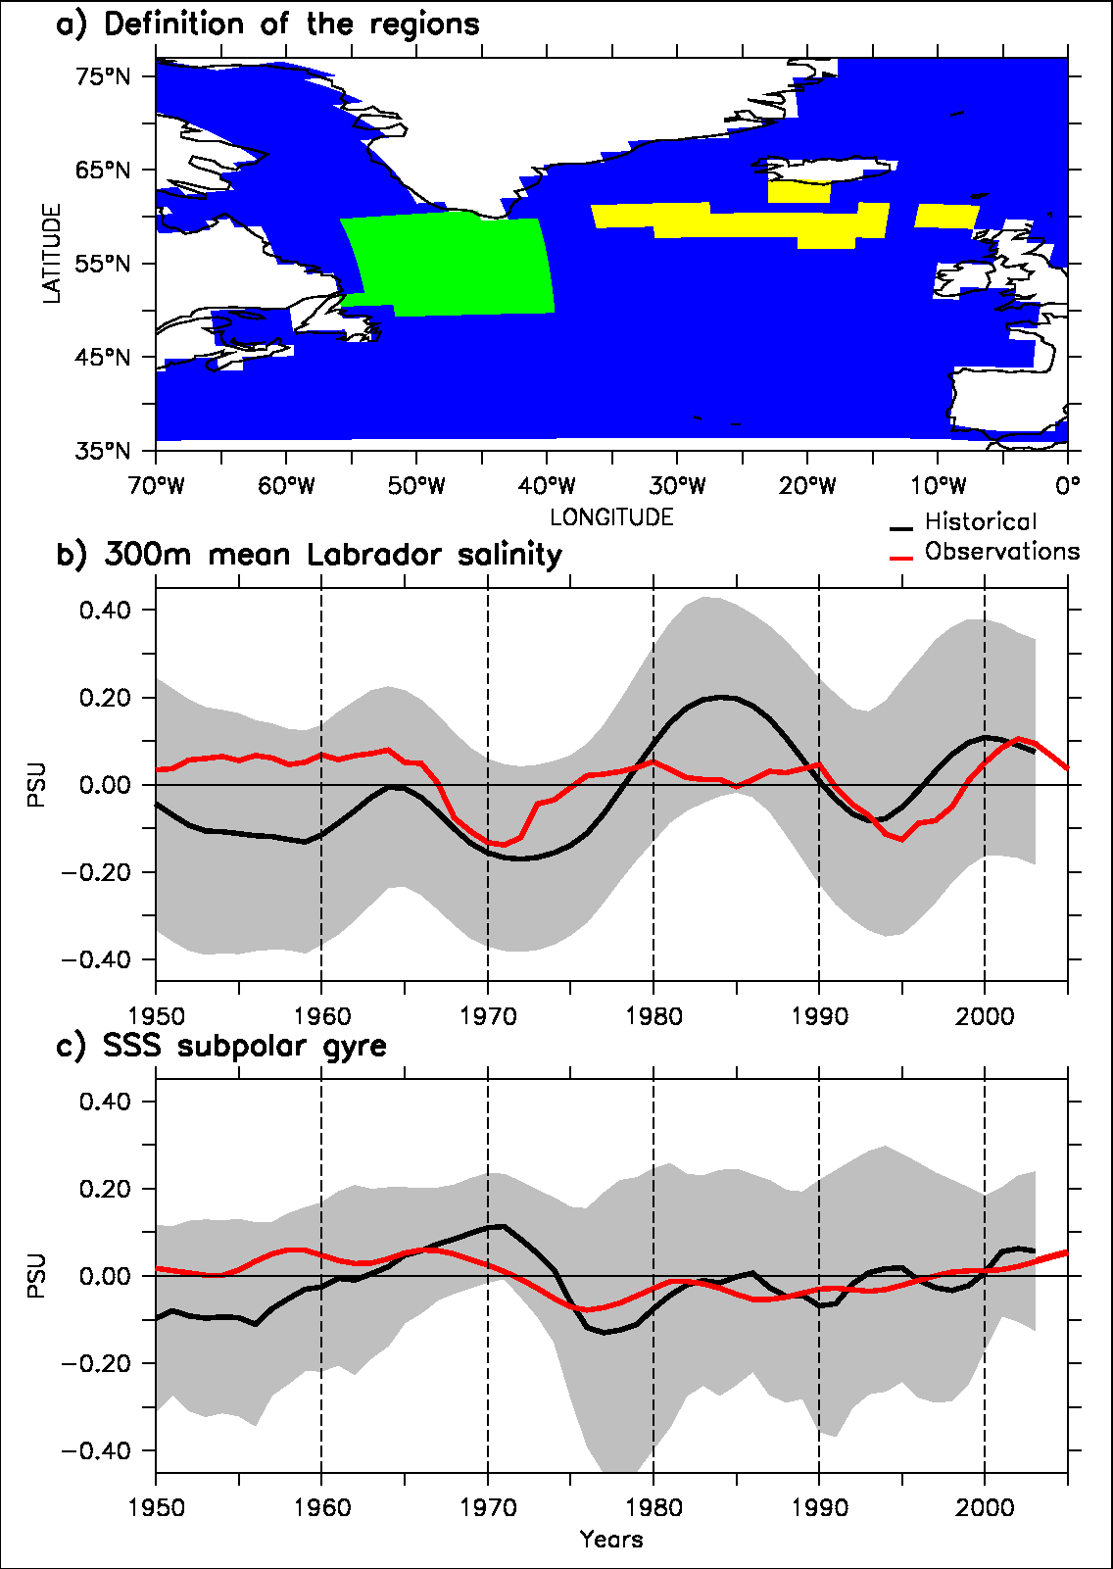
Comparison with in situ salinity data
Labrador data available from Canadian Bedford Institute of Oceanography
Reconstruction of SSS variability over the east subpolar gyre (Reverdin 2010)
Agreement between historical and data (20-yr sliding window correlation, p<0.1)
An explanation for two GSAs!
Swingedouw et al., Nature Com.. 2015

Slide 13
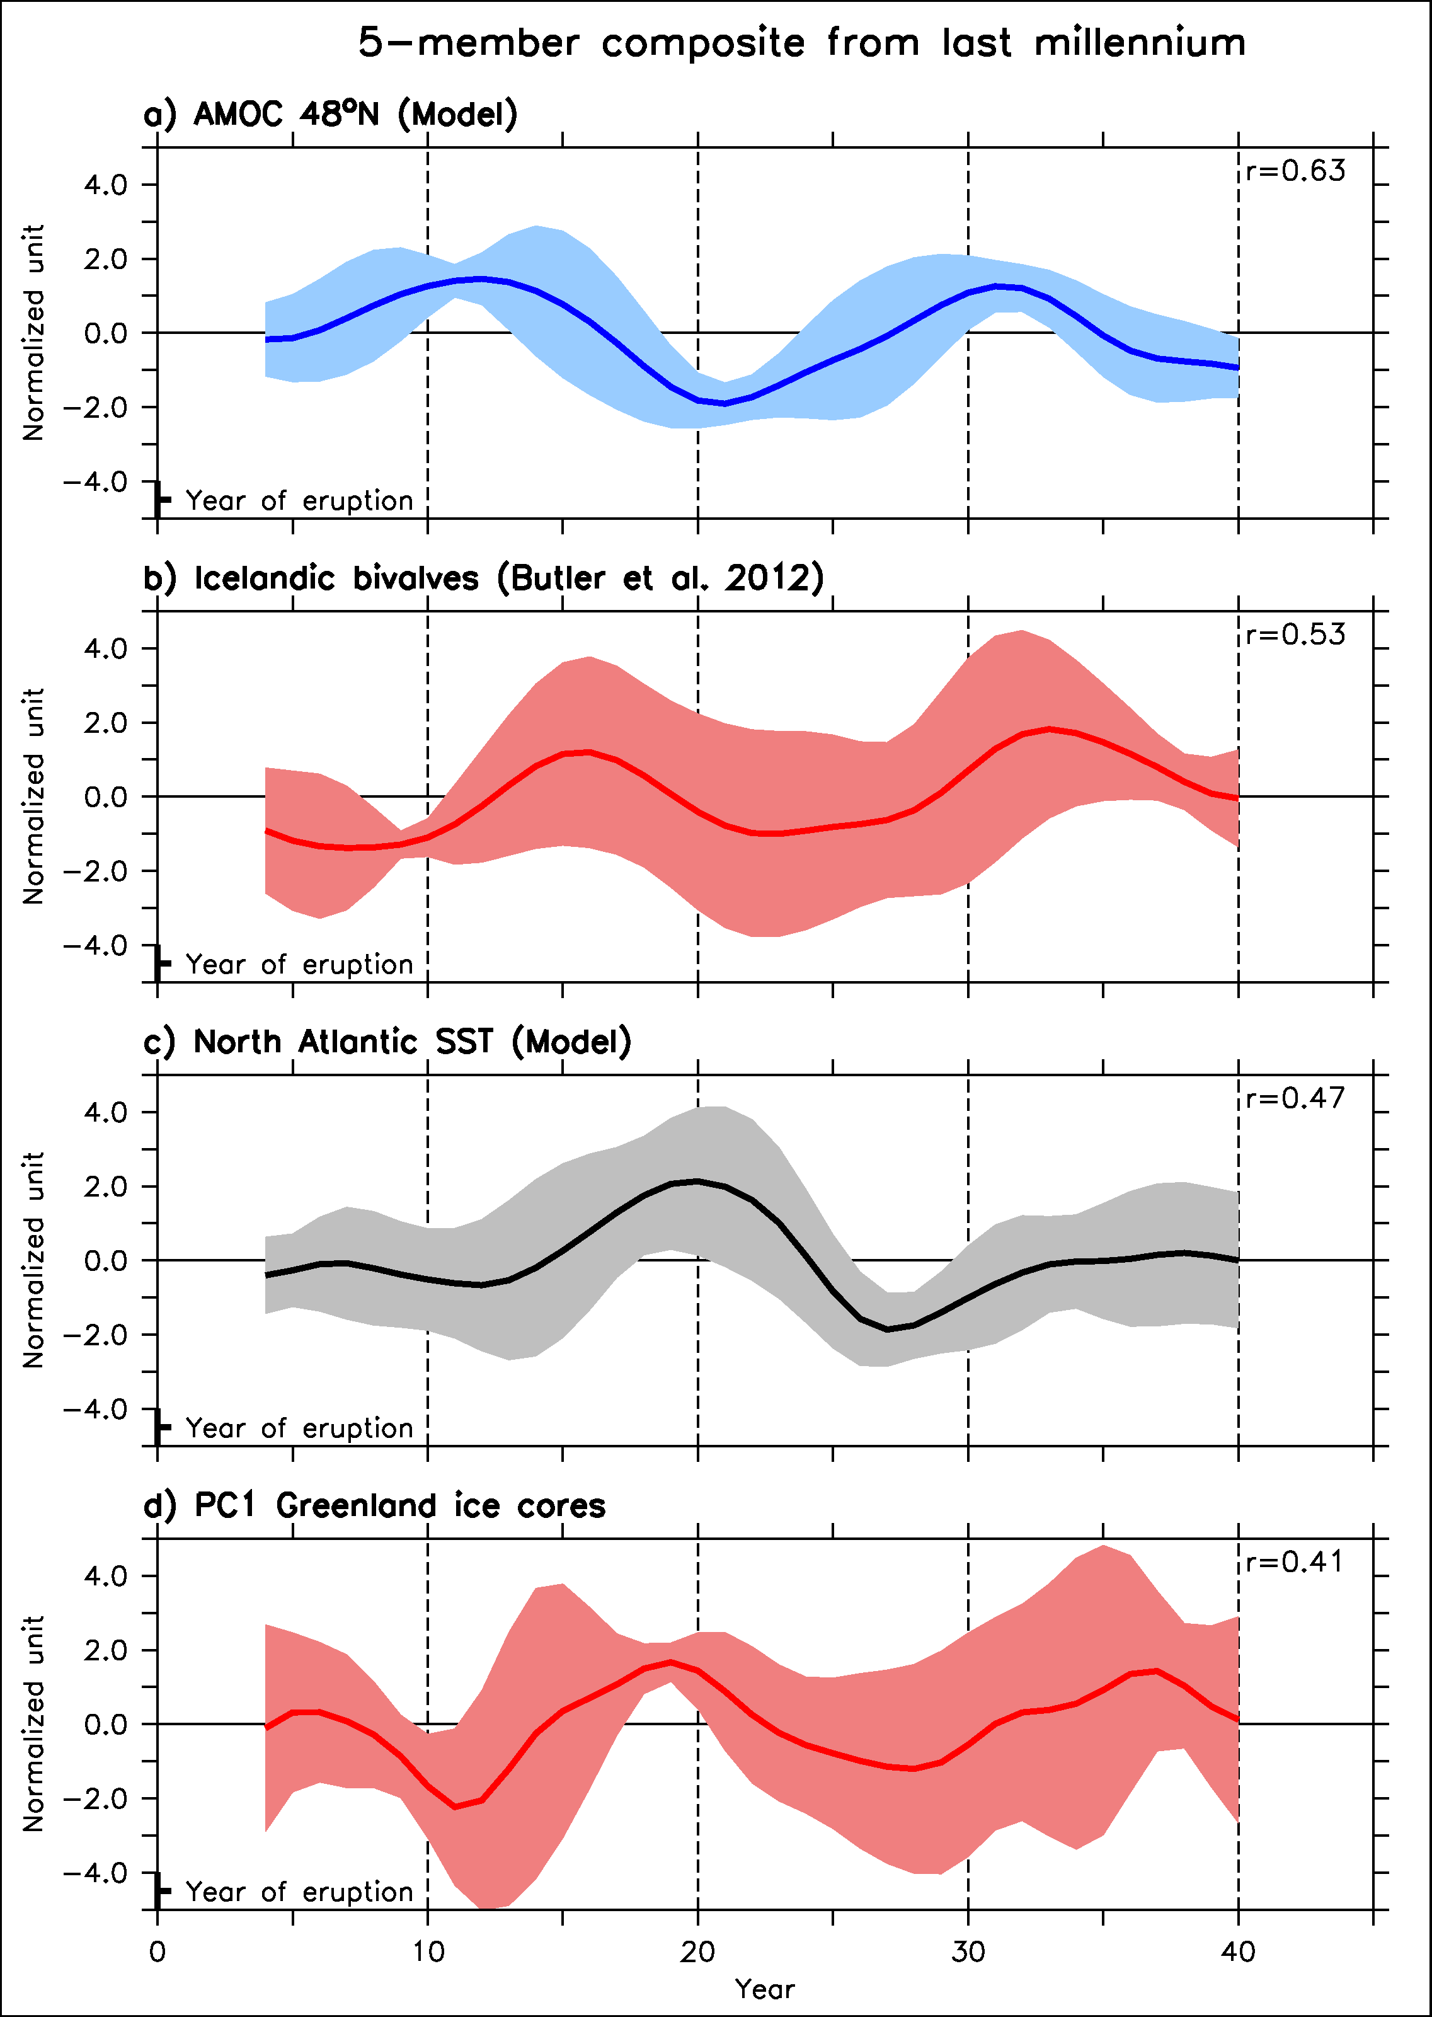
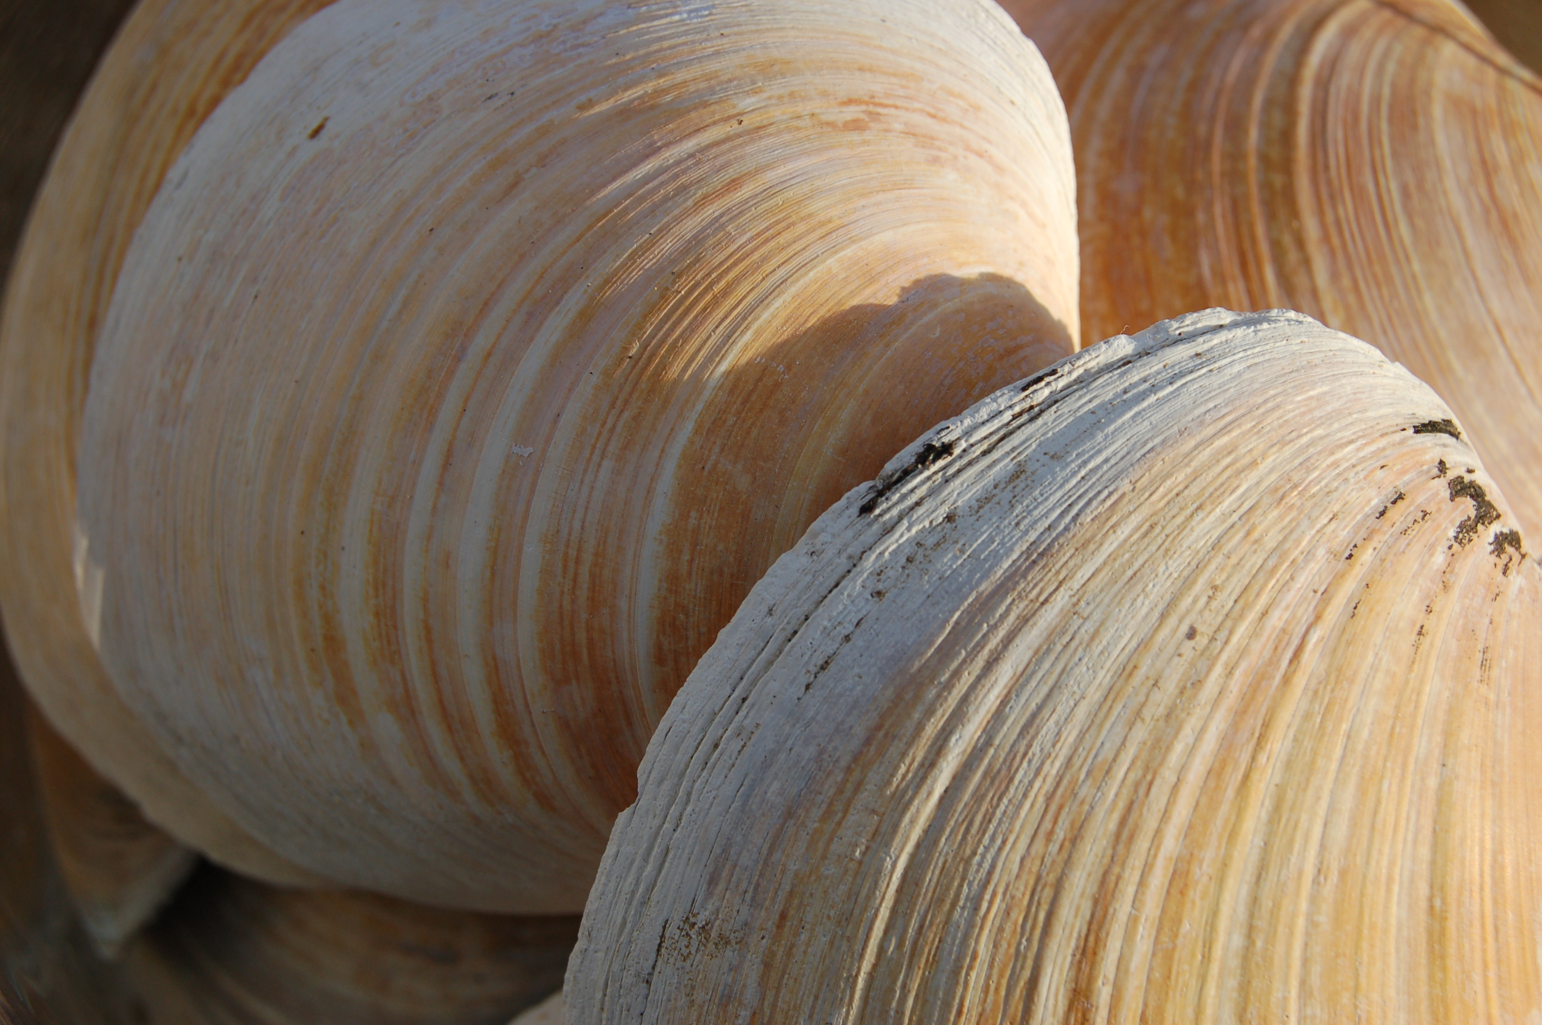
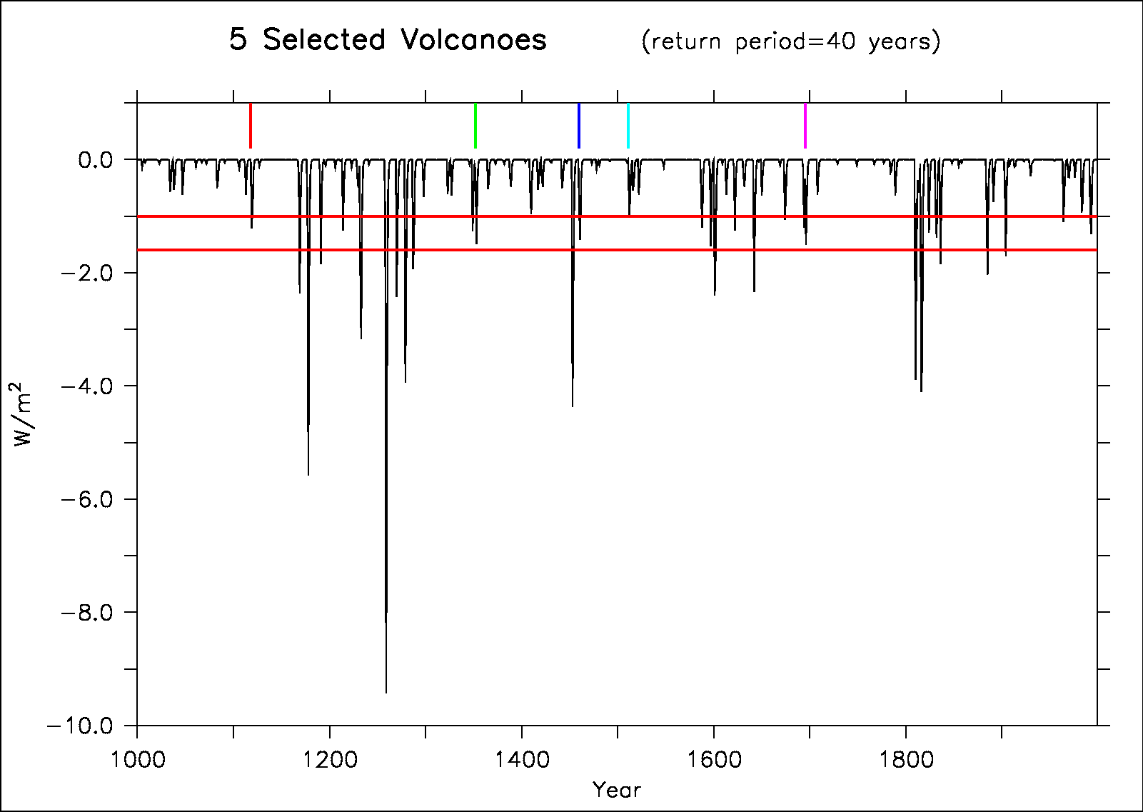
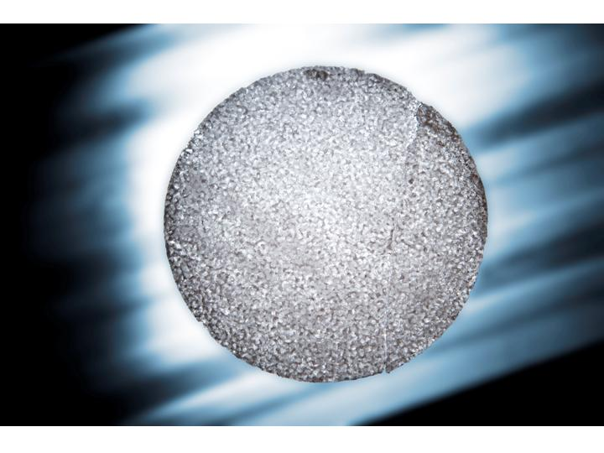
Last millennium perspective
We select the same timeseries following volcanoes in data and SST in the North Atlantic from the model
Significant correlation both in model and data, following AMOC variations by around 5 years
Notes:
Explain better the link AMOC temperature: bring warm water in Nordic Seas after a delay of 5-7 years
Faire PC1-HadISST in supplementary

Slide 14
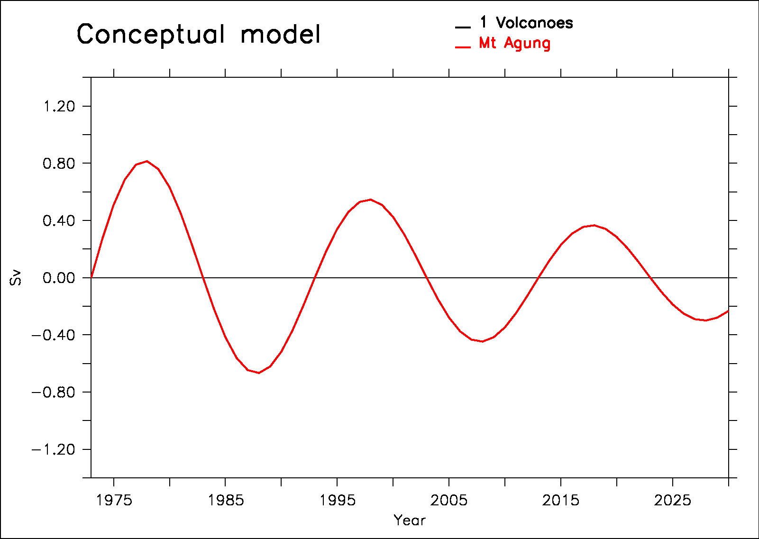
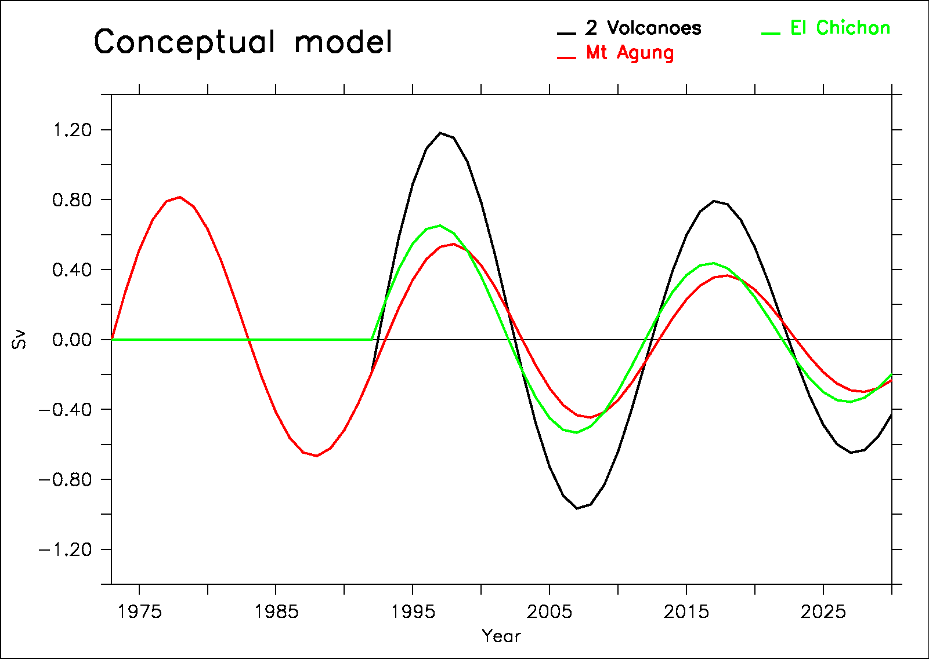
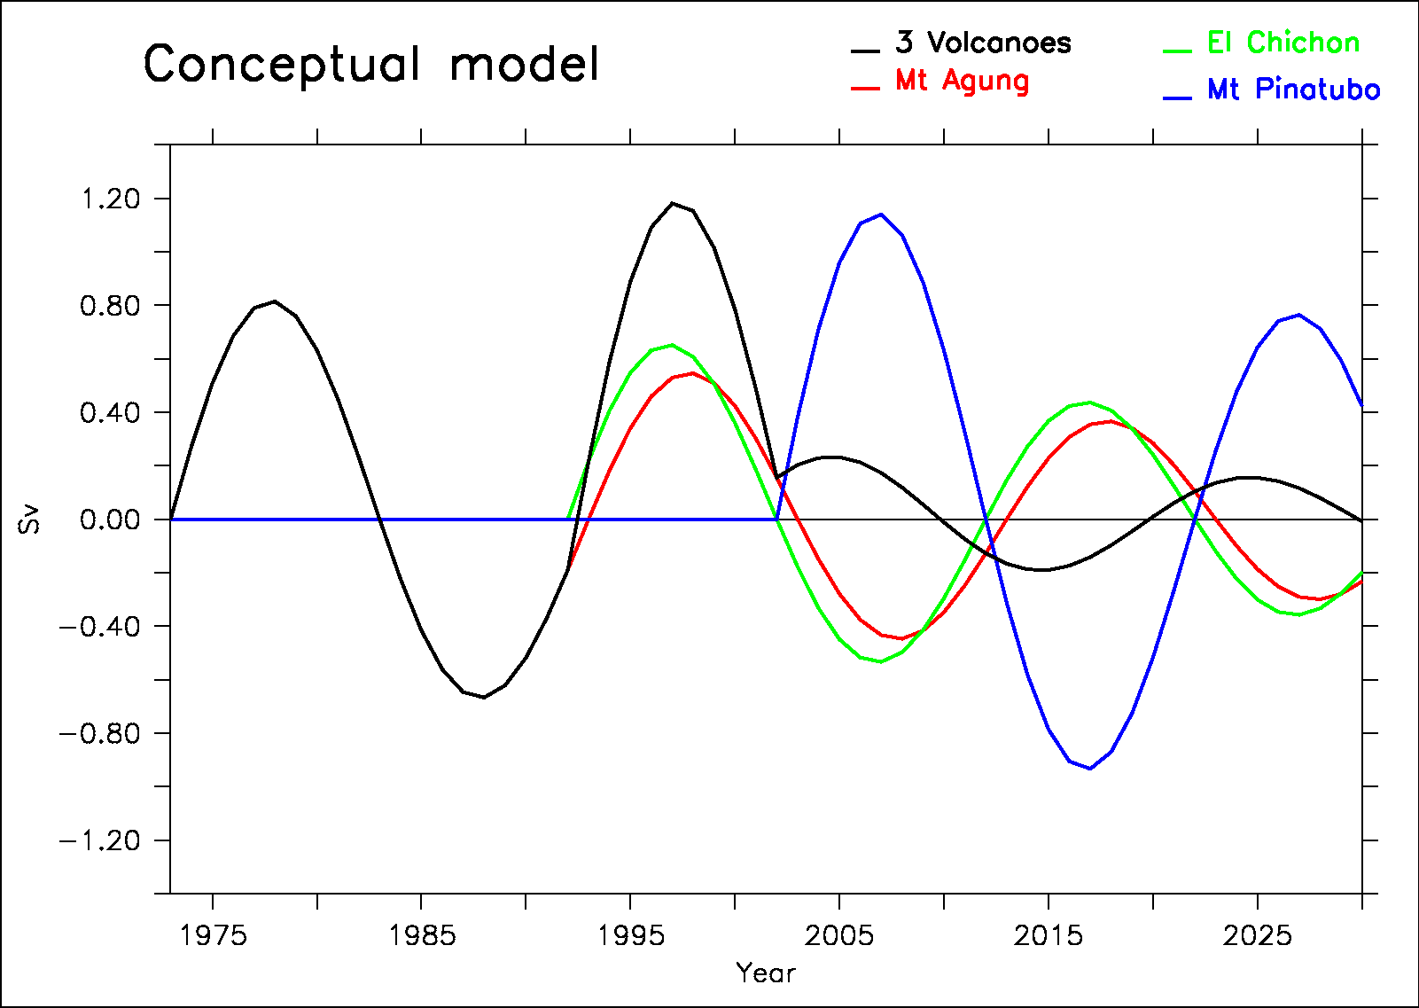
A conceptual model to explain AMOC variability in the model
We propose a conceptual model based on:
harmonic response to volcanoes
Linear response to radiative forcing (GHG)
Notes:
Mettre la somme en gras niveau 3 (le noir…)

Slide 15
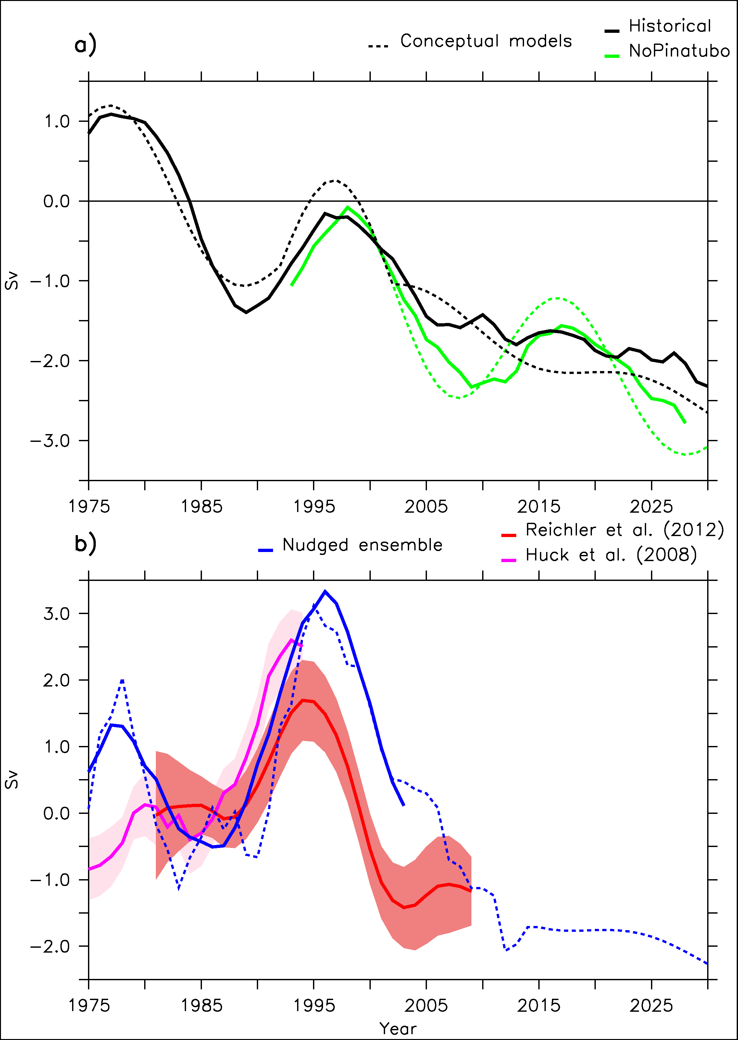
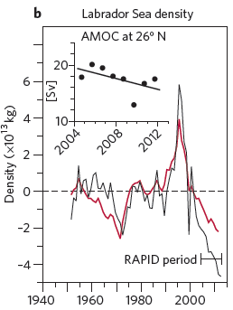
AMOC response in the IPSL-CM5A-LR model
Robson et al. 2014

Slide 16
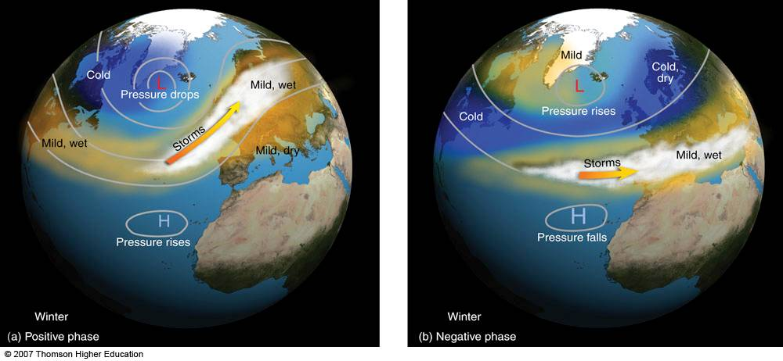
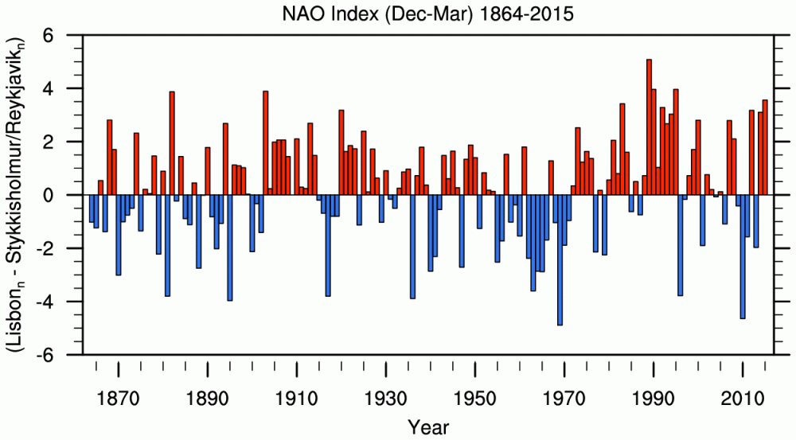
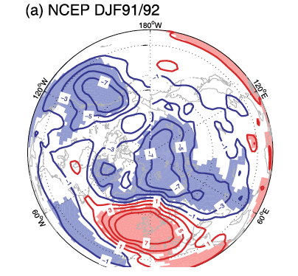
Impact of volcanoes on the NAO
L’oscillation Nord Atlantique (NAO)
NAO first mode of variability in the atmosphere SLP over the North Atlantic sector
Pinatubo has been followed by postive NAO, and this could be due to dynamical adjustment in the atmosphere (Robock et al. 1992, Ottera et al. 2008)
Années

Slide 17
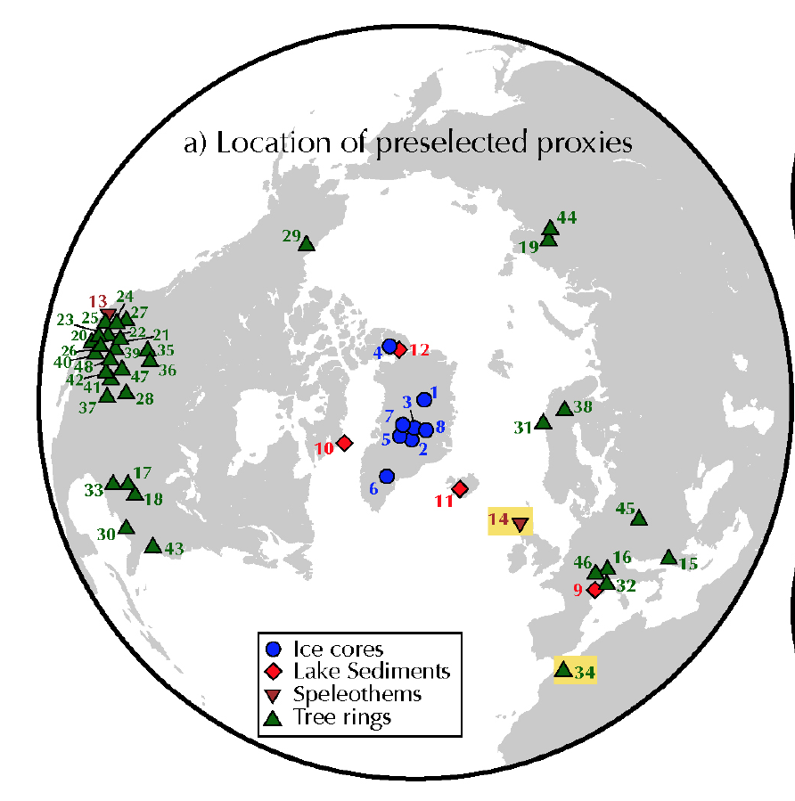
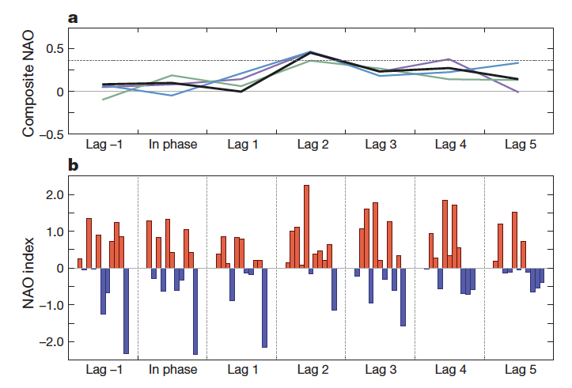
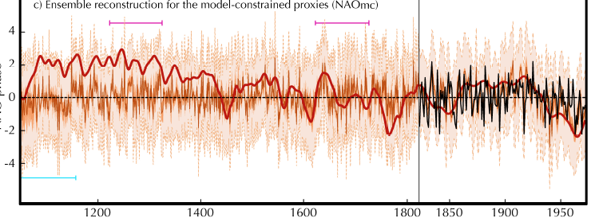
Impact of volcanoes on the NAO
Localisation des proxies
Confirmed over the last millennium in new NAO reconstruction from Ortega et al. (Nature 2015) following 10 main volcanic eruption over last millennium
Impact of this effect in our conceptual model?
Ortega et al. Nature 2015
Reconstruction of NAO over last millennium
Trouet et al. 2009
Ortega et al. 2015

Slide 18
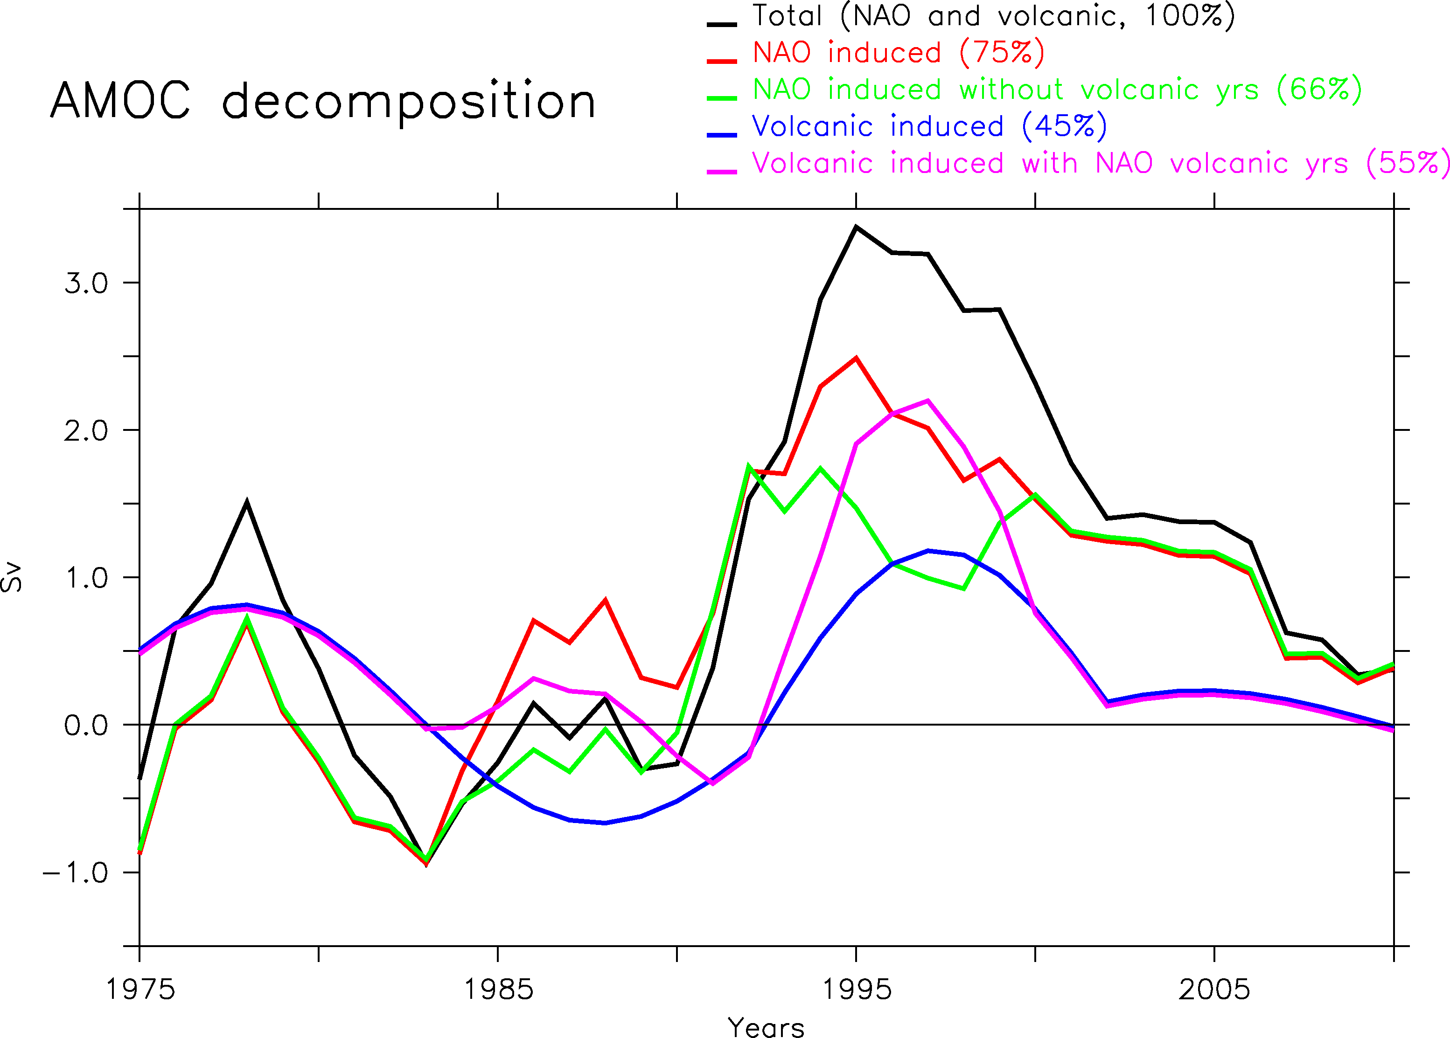
Full effect of volcanoes on the AMOC
Volcanoes also impact NAO and therefore the AMOC!
We can include such an effect in our conceptual model.

Slide 19
Conclusions
Volcanic eruption precedes an AMOC maximum by around 10-15 years in IPSLCM5A-LR model
Impact of volcanoes also very clear in a 9-member CMIP5 ensemble, BUT exact mechanism unclear (cf. Menary et al. 2015)
Consistent with in situ salinity data in the subpolar gyre
And data of Greenland and Iceland over the last millennium
large body of evidence supporting the validity of the mechanism in the real world
Effect of Pinatubo: destructive interference!
Accounting for a better representation of radiative forcing?

Slide 20
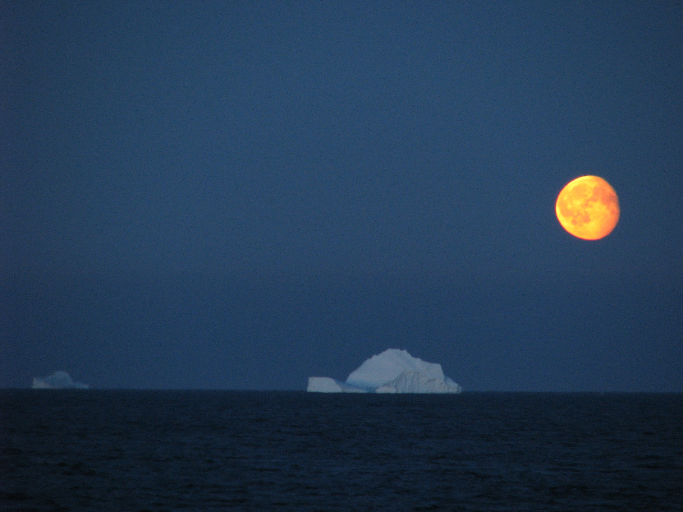
Thank you!
Didier.Swingedouw@u-bordeaux1.fr
Courtesy of Bruno Ferron, OVIDE 2010

Slide 21
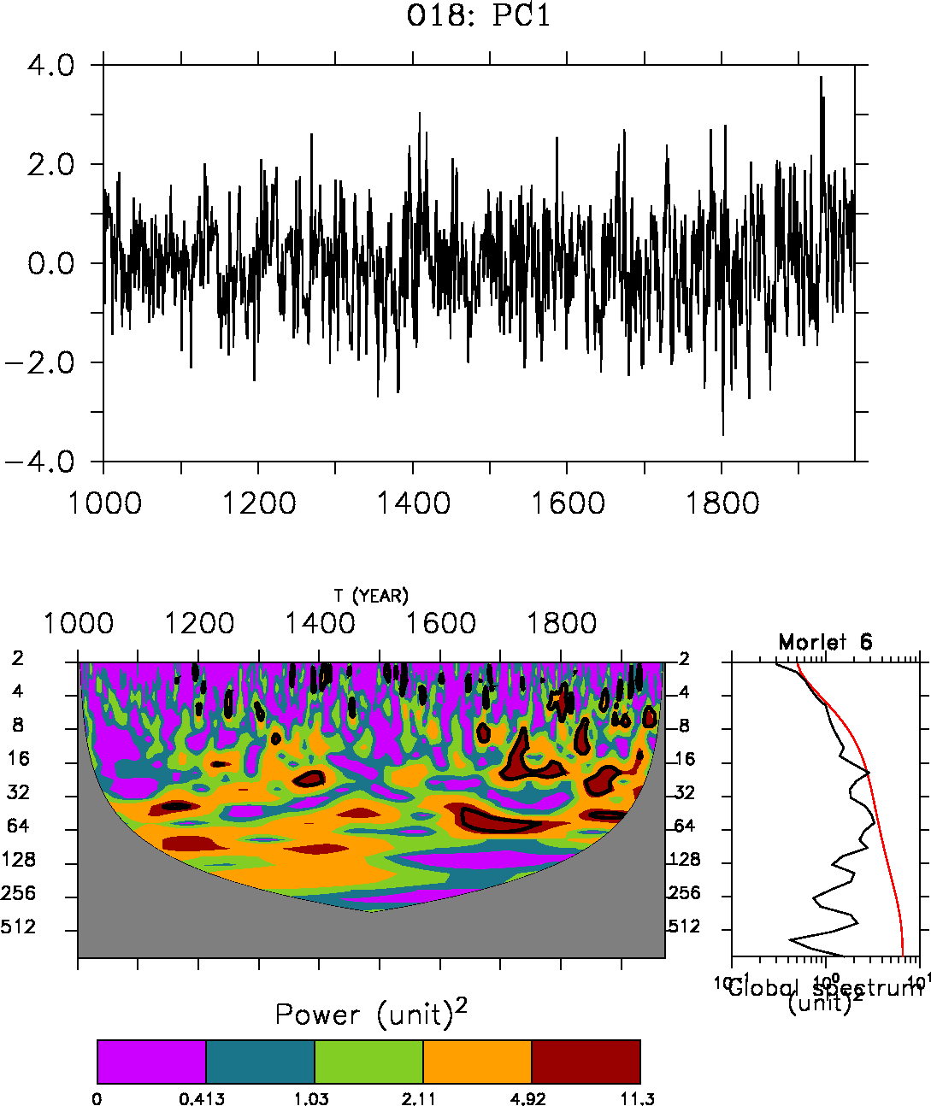
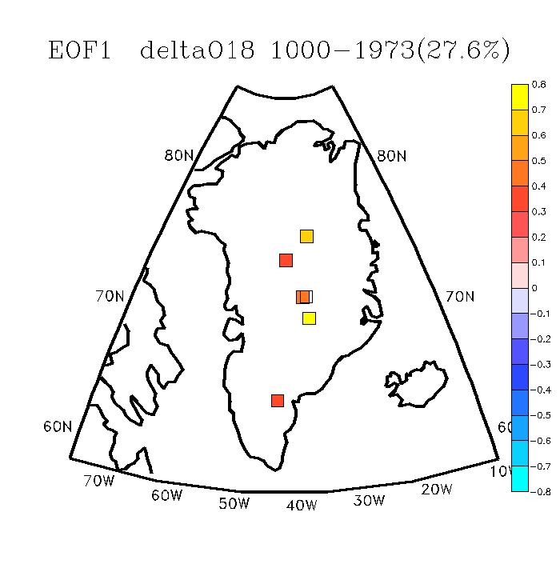
Greenland data
20-yr preferential variability
EOF1 of a compilation of 6 ice cores reconstructing Greenland δ¹⁸O over the last millennium (Ortega et al. 2014)
PC1 δ¹⁸O ice cores
EOF1 δ¹⁸O ice cores
B18
NGRIP
GISP2
GRIP
Crete
DYE-3

Slide 22
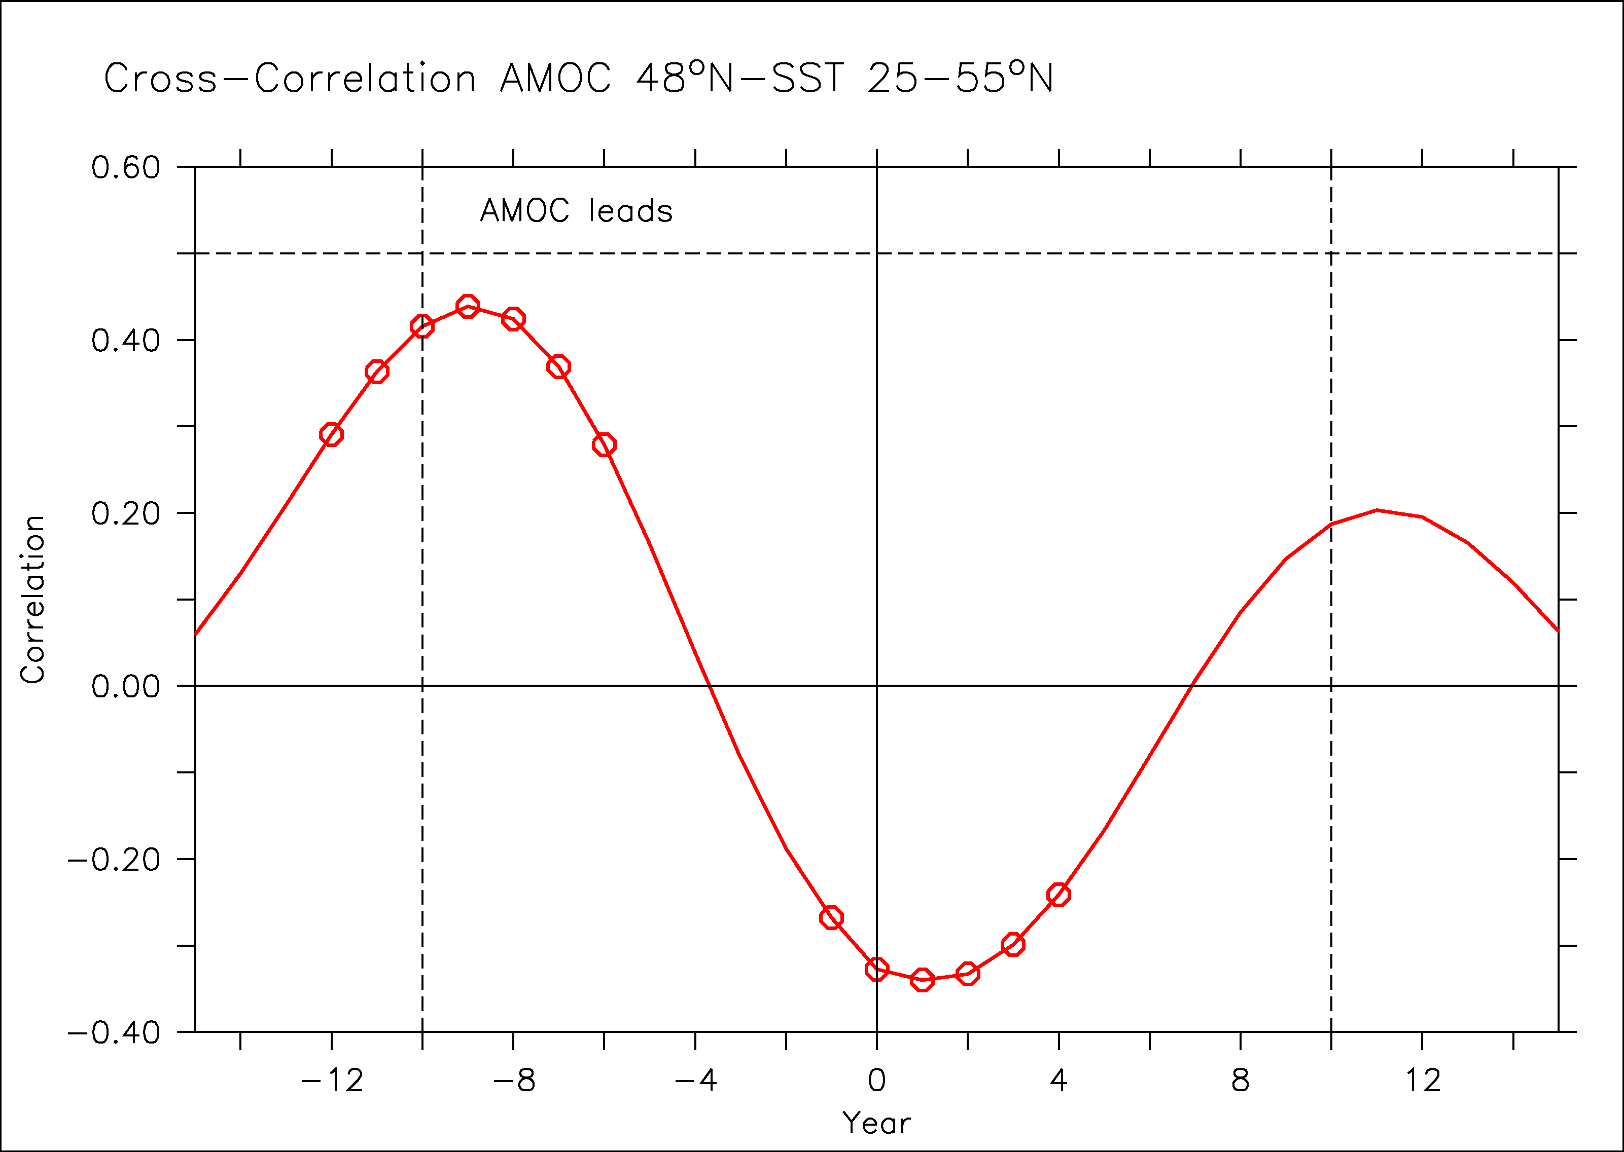
Link Greenland-AMO
Greenland as high-resolution proxy of North Atlatic SST (AMO)?
AMOC leads AMO in the model by 5-10 years

Slide 23
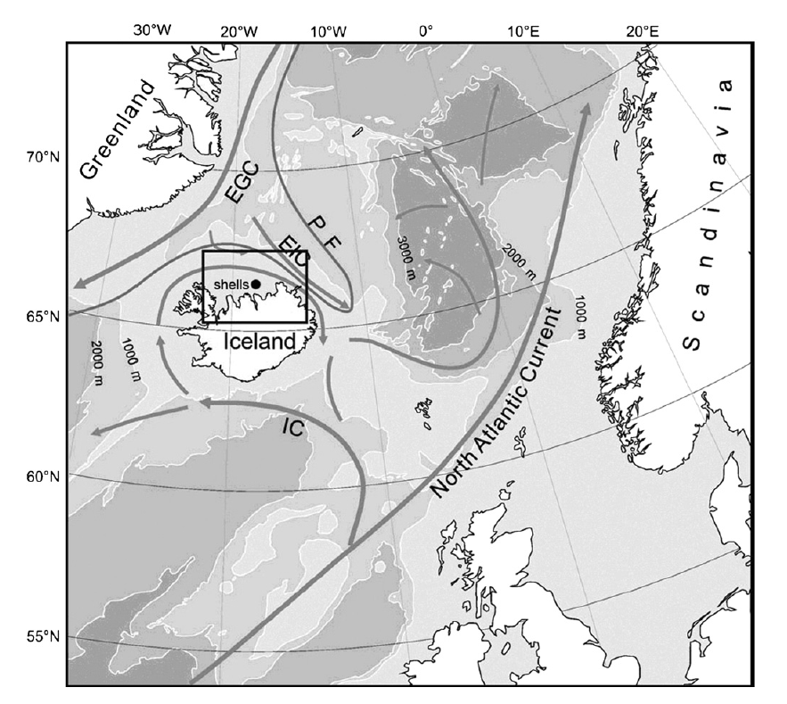
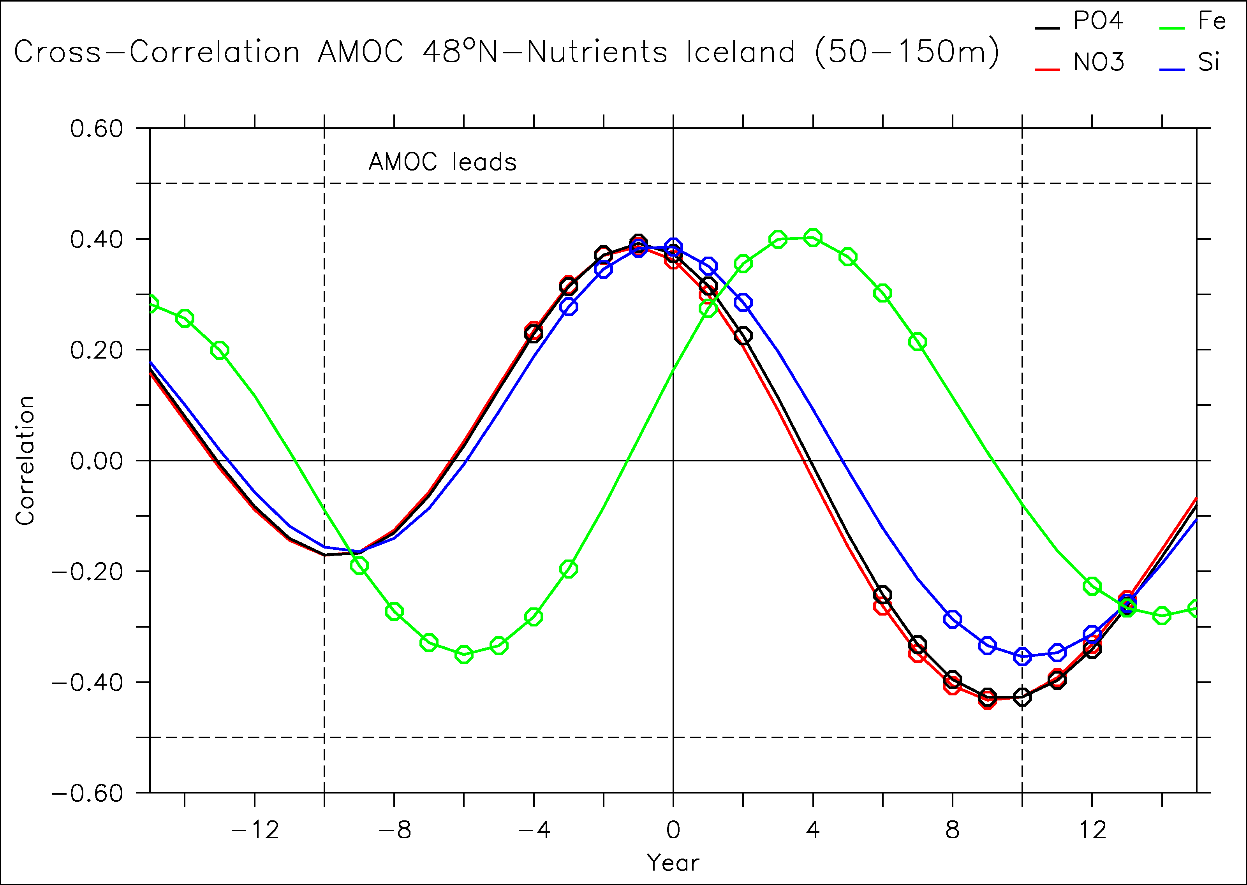
A paleo-indicator of the subpolar AMOC?
Butler et al. (2013): bivalve as a very high temporal resolution proxy
Not SST, rather related to nutrient supply
Pseudo-proxy approach: is there a link between nutrient and AMOC in the model north of Iceland?
AMOC leads nutrient supply north of Iceland by 1-3 years
Butler et al. 2013

Slide 24
Implication for recent variability
Climatic index
Agung
15 yrs
Model free
1963
1982
1991
Time
2006

Slide 25
Implication for recent variability
Climatic index
El Chichon
Agung
15 yrs
1963
1982
1991
Time
2006

Slide 26
Implication for recent variability
Destructive interference?
Climatic index
El Chichon
Agung
Pinatubo
15 yrs
1963
1982
1991
Time
2006

Slide 27
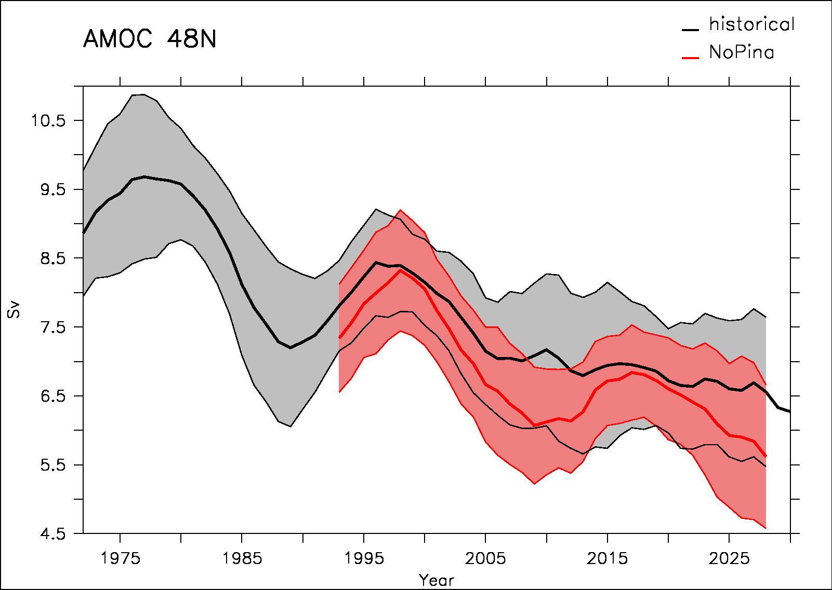
Removing Pinatubo within IPSL-CM5A-LR model
Historical
No Pinatubo
The sensitivity ensemble without Pinatubo shows a larger decrease in the early 2000s as compared to historical ensemble
Then a partial recovery in the late 2010s

Slide 28
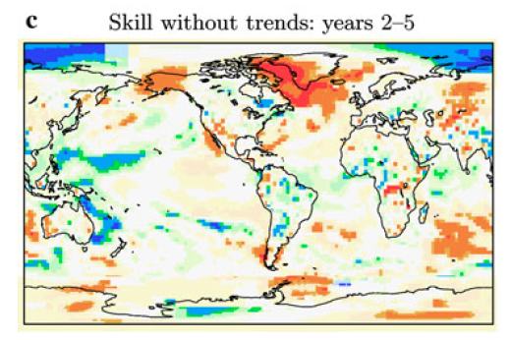
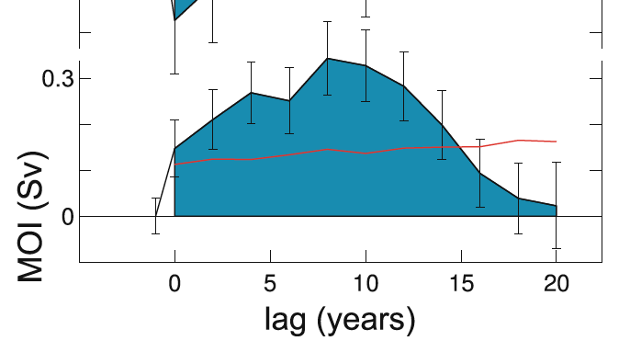
Background
t2m skill without trends: years 2-5
AMOC: a key player for decadal prediction
Volcanic impact on AMOC (Ottera et al. 2011, Iwi et al. 2010, Mignot et al. 2011…)
Bi-decadal variability in the North Atlantic:
  in several models (Frankcombe et al. 2010…)
  and in data (Chylek et al. 2011, Sicre et al. 2008, Divine & Dick 2006… )
Van Oldenborgh et al. 2012
Zanchettin et al. 2012

Slide 29
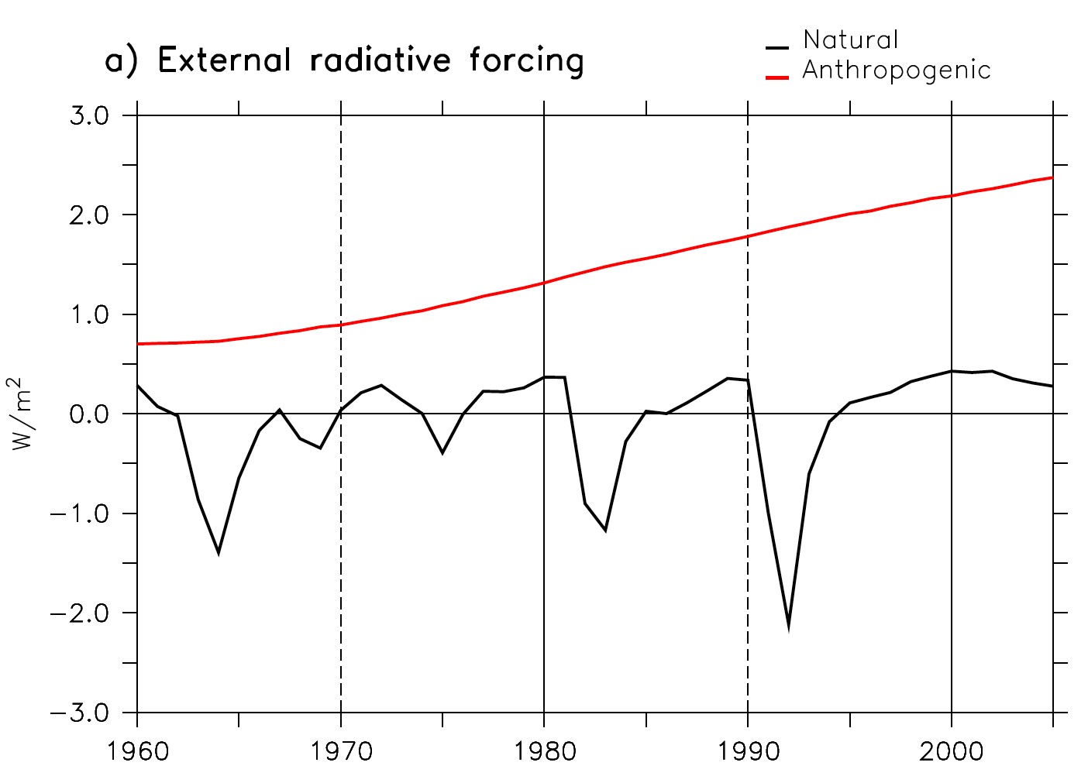
Experimental design
IPSL-CM5A-LR climate model
5-member historical ensemble (natural and anthropogenic forcing)
5-member initialised ensemble nudged with SST anomalies
5-member sensitivity ensemble without Pinatubo
CMIP5 ensemble
Comparison with existing in situ SSS data
Paleo-climate support
O
Agung
Pinatubo
El Chichon

Slide 30
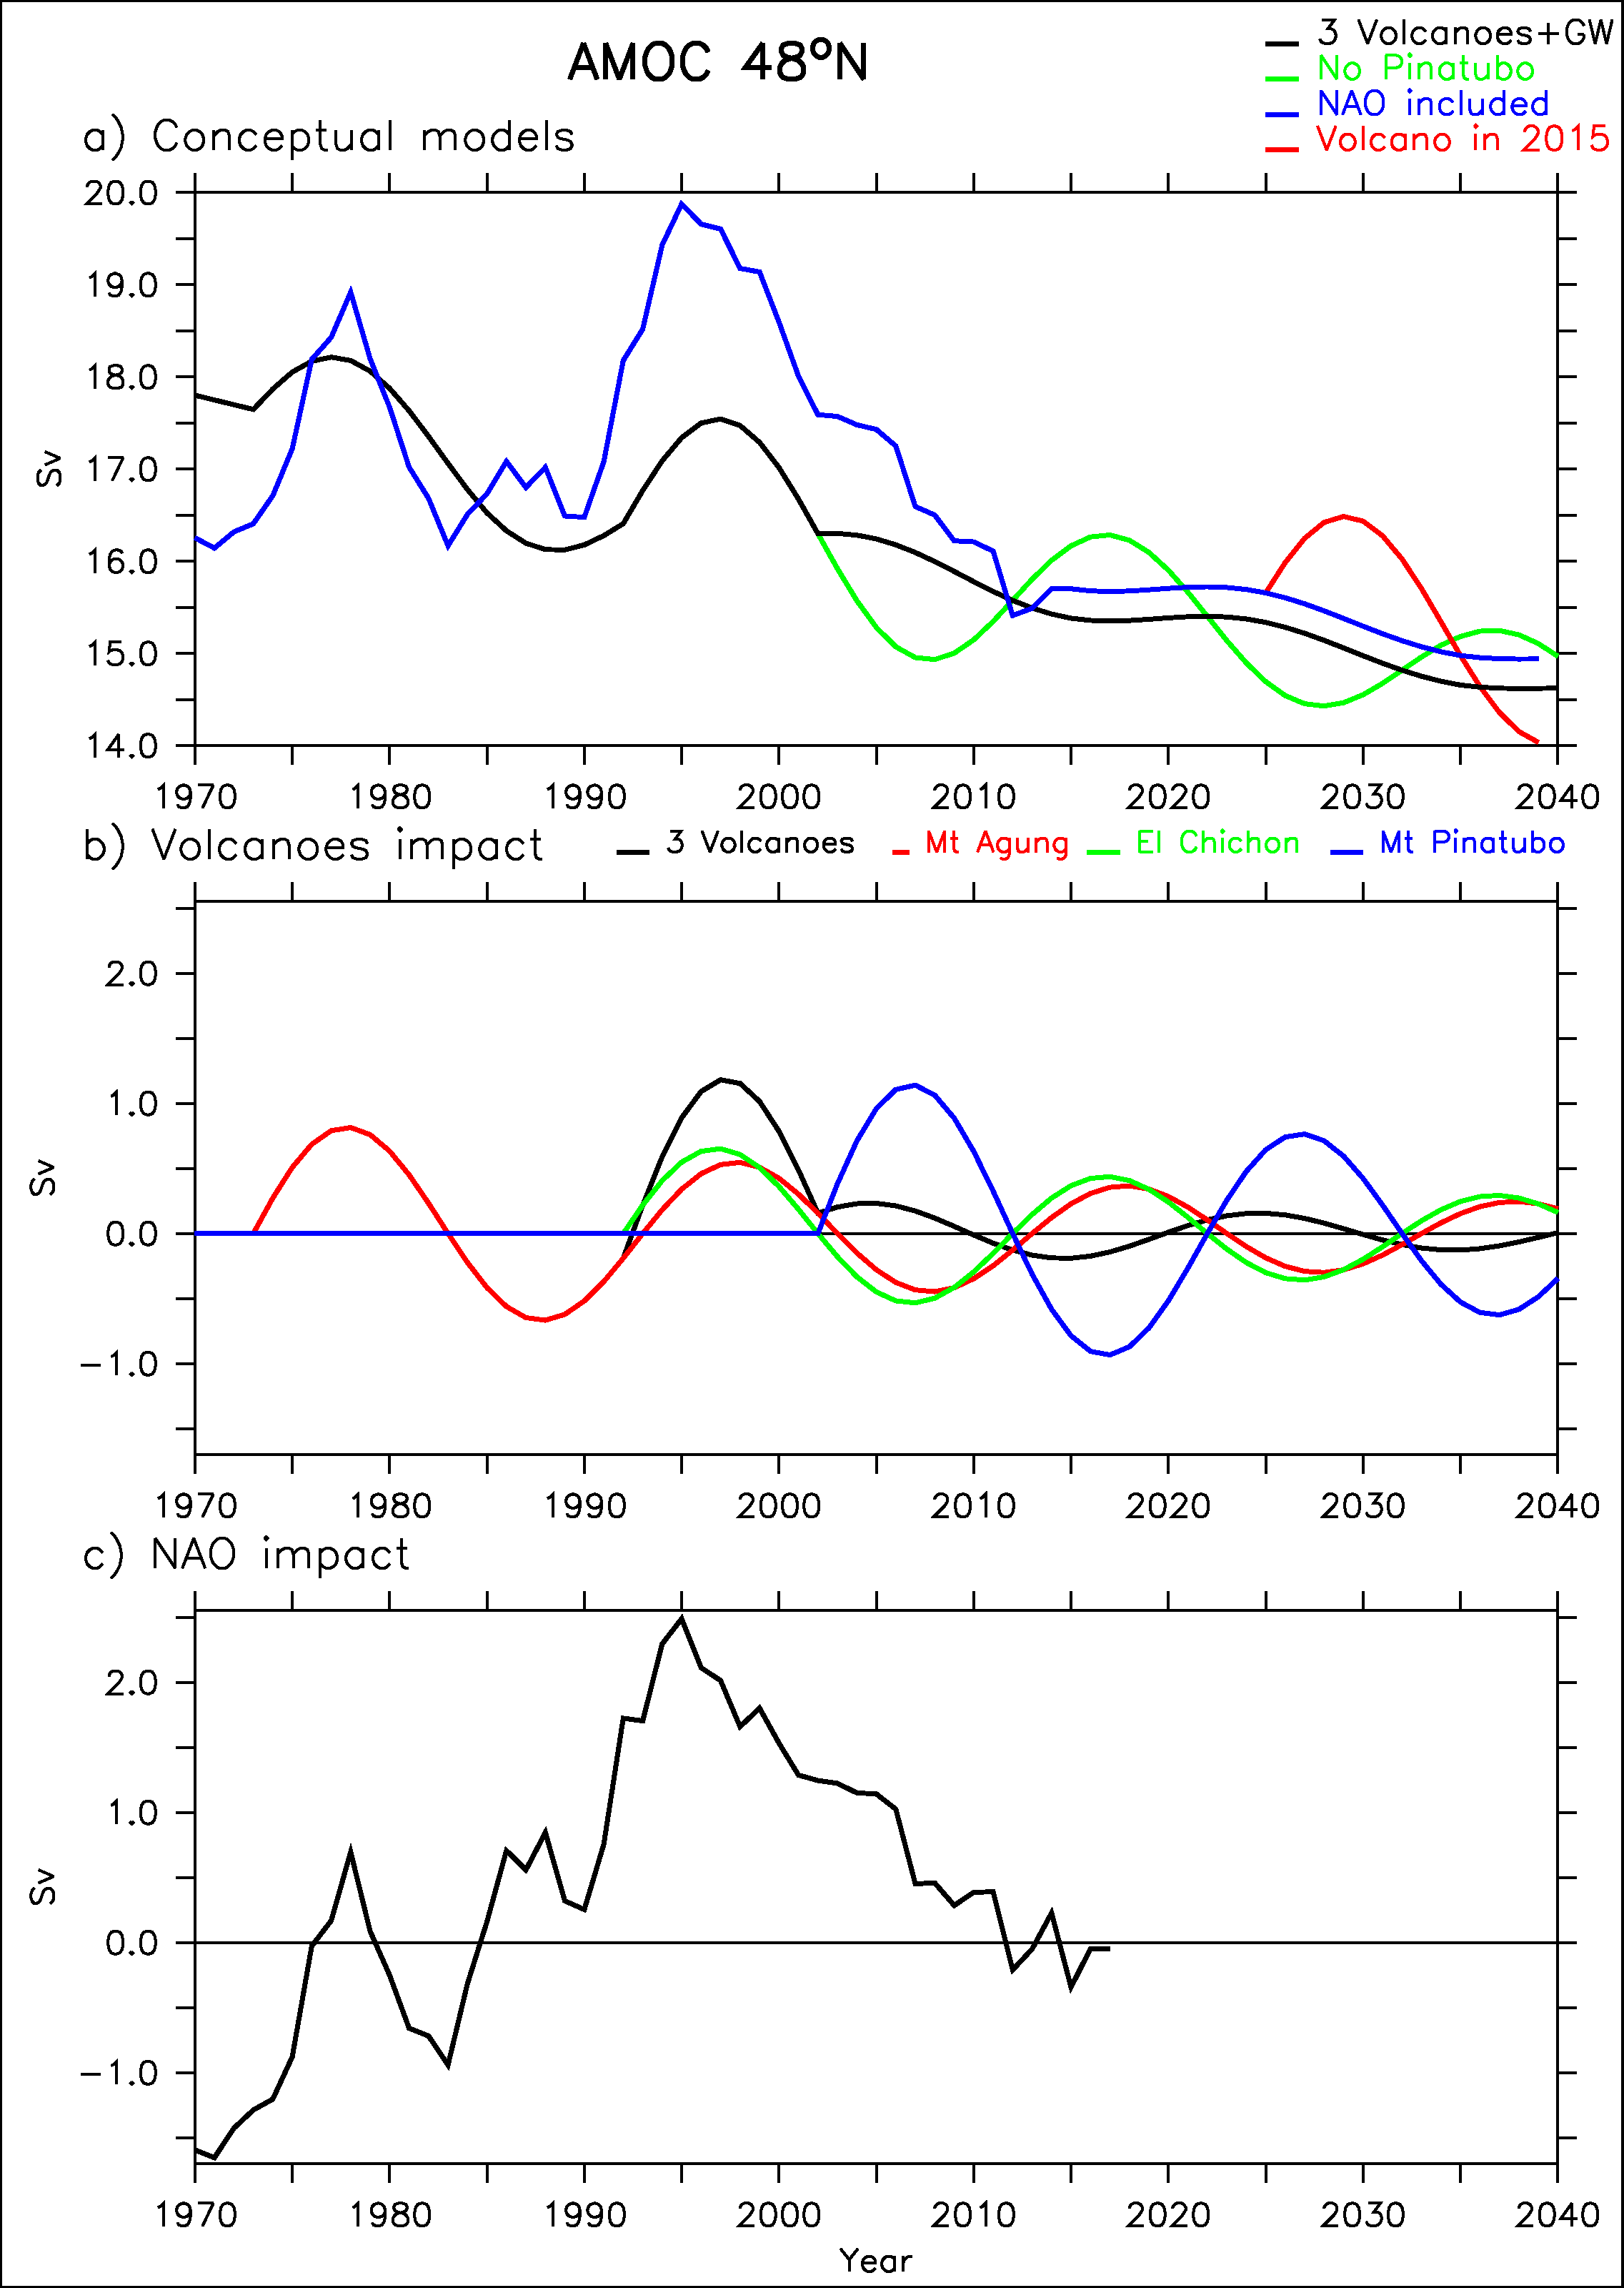
Comparison of the AMOC forcings
NAO forcing is larger than that from volcanoes
Over the period 1973-2018:
  Std volcanoes =0.54 Sv
  Std NAO = 0.93 Sv

Slide 31
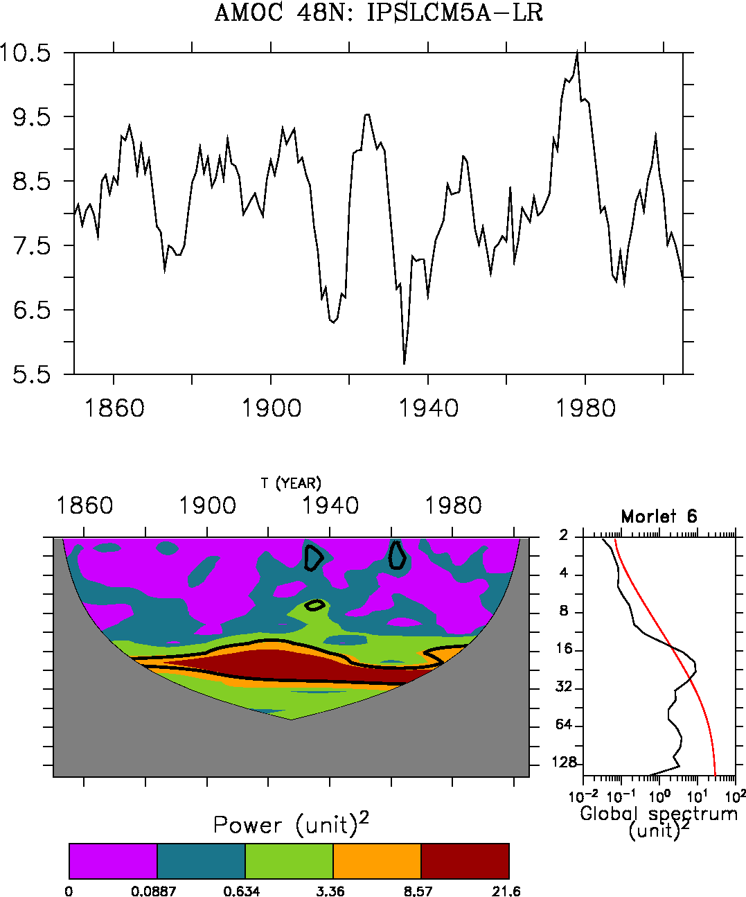
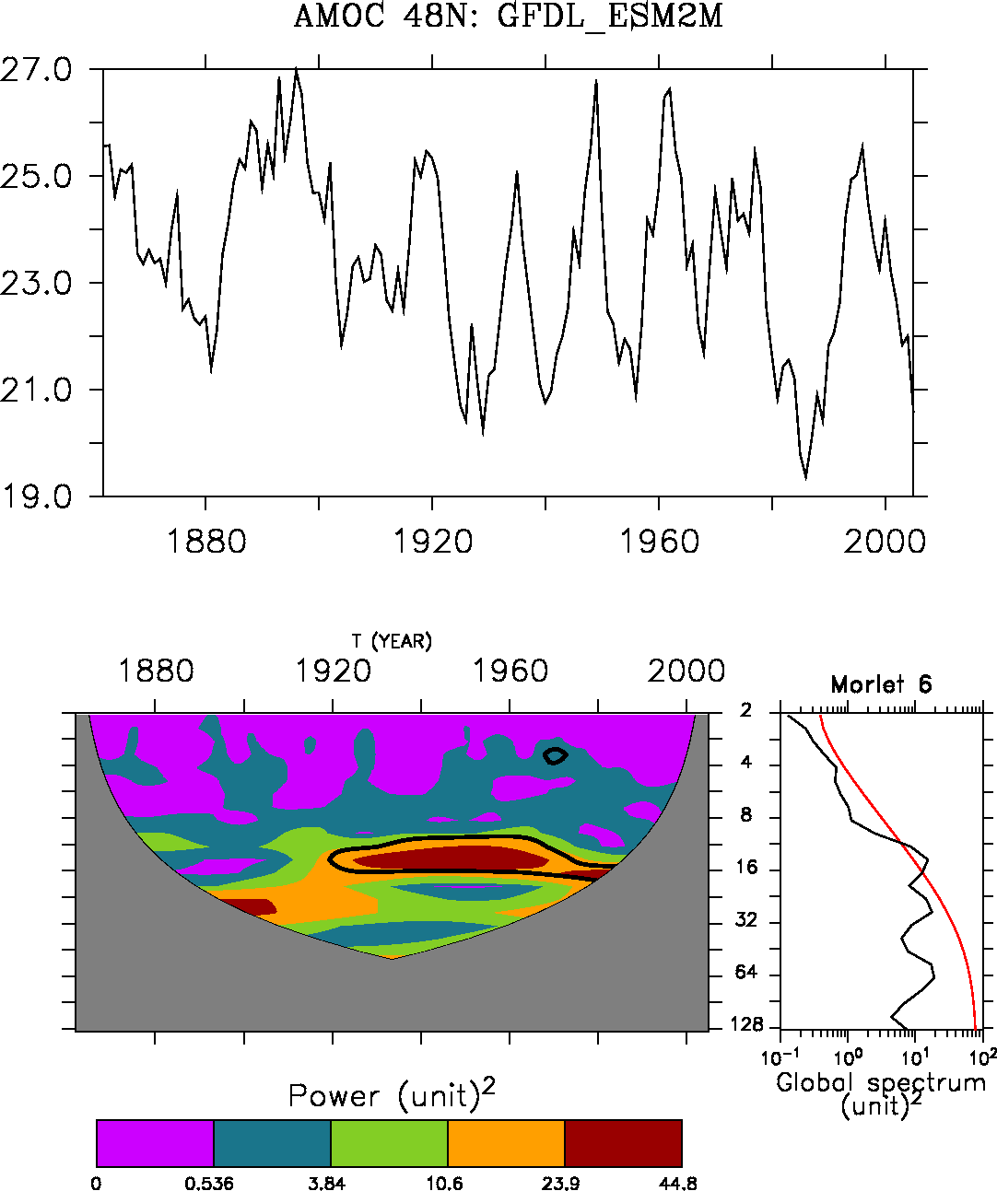
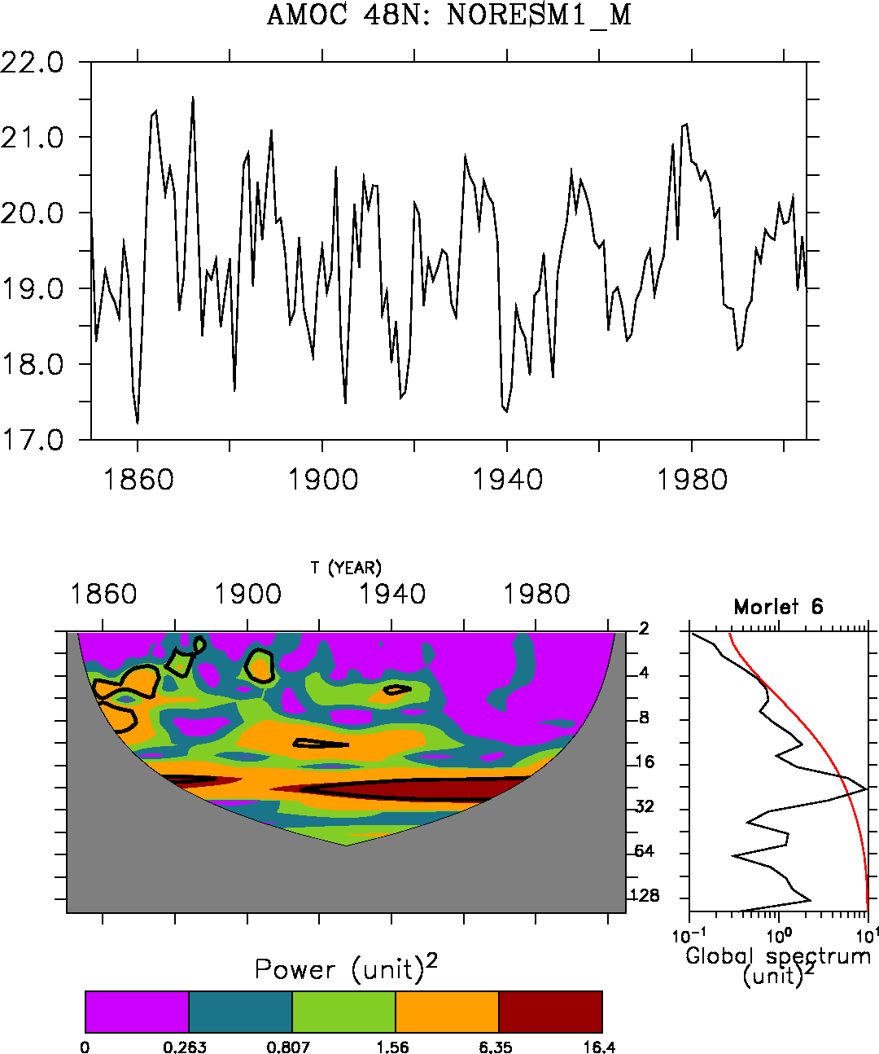
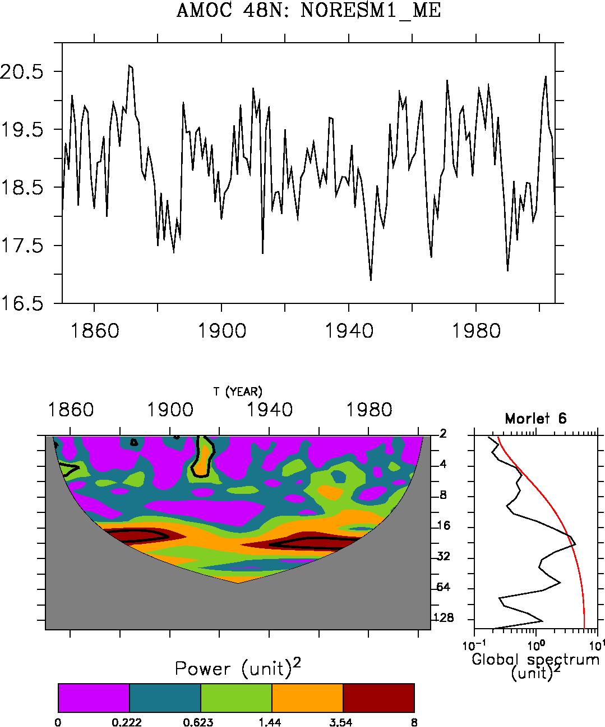
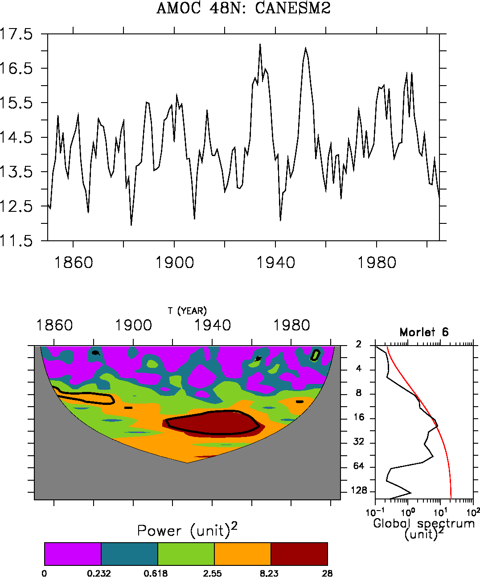
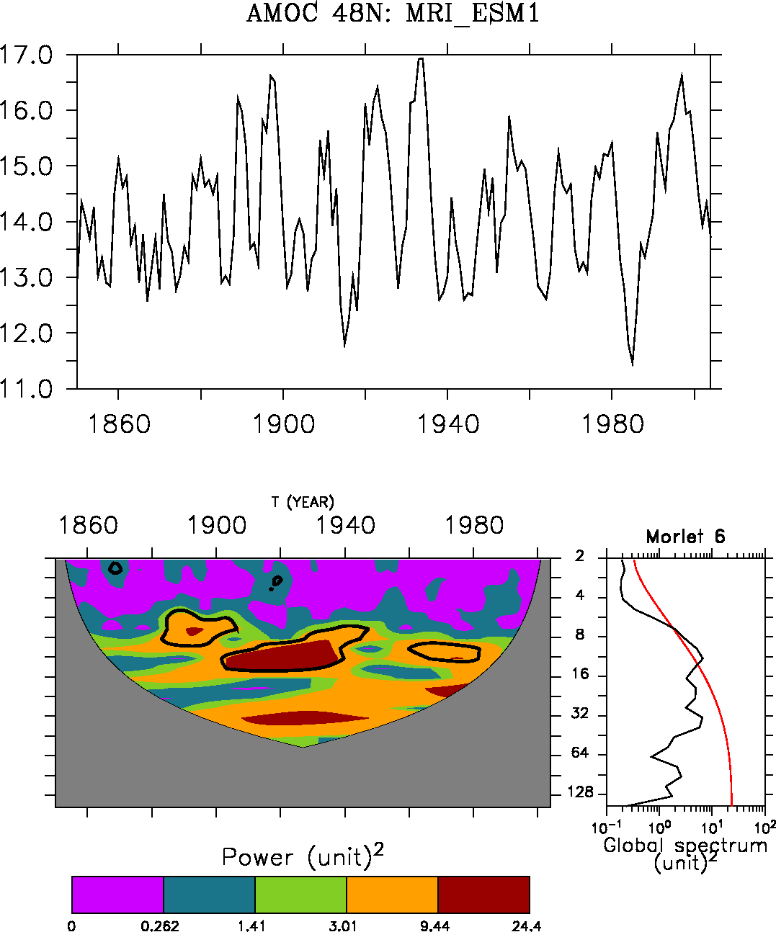

Slide 32
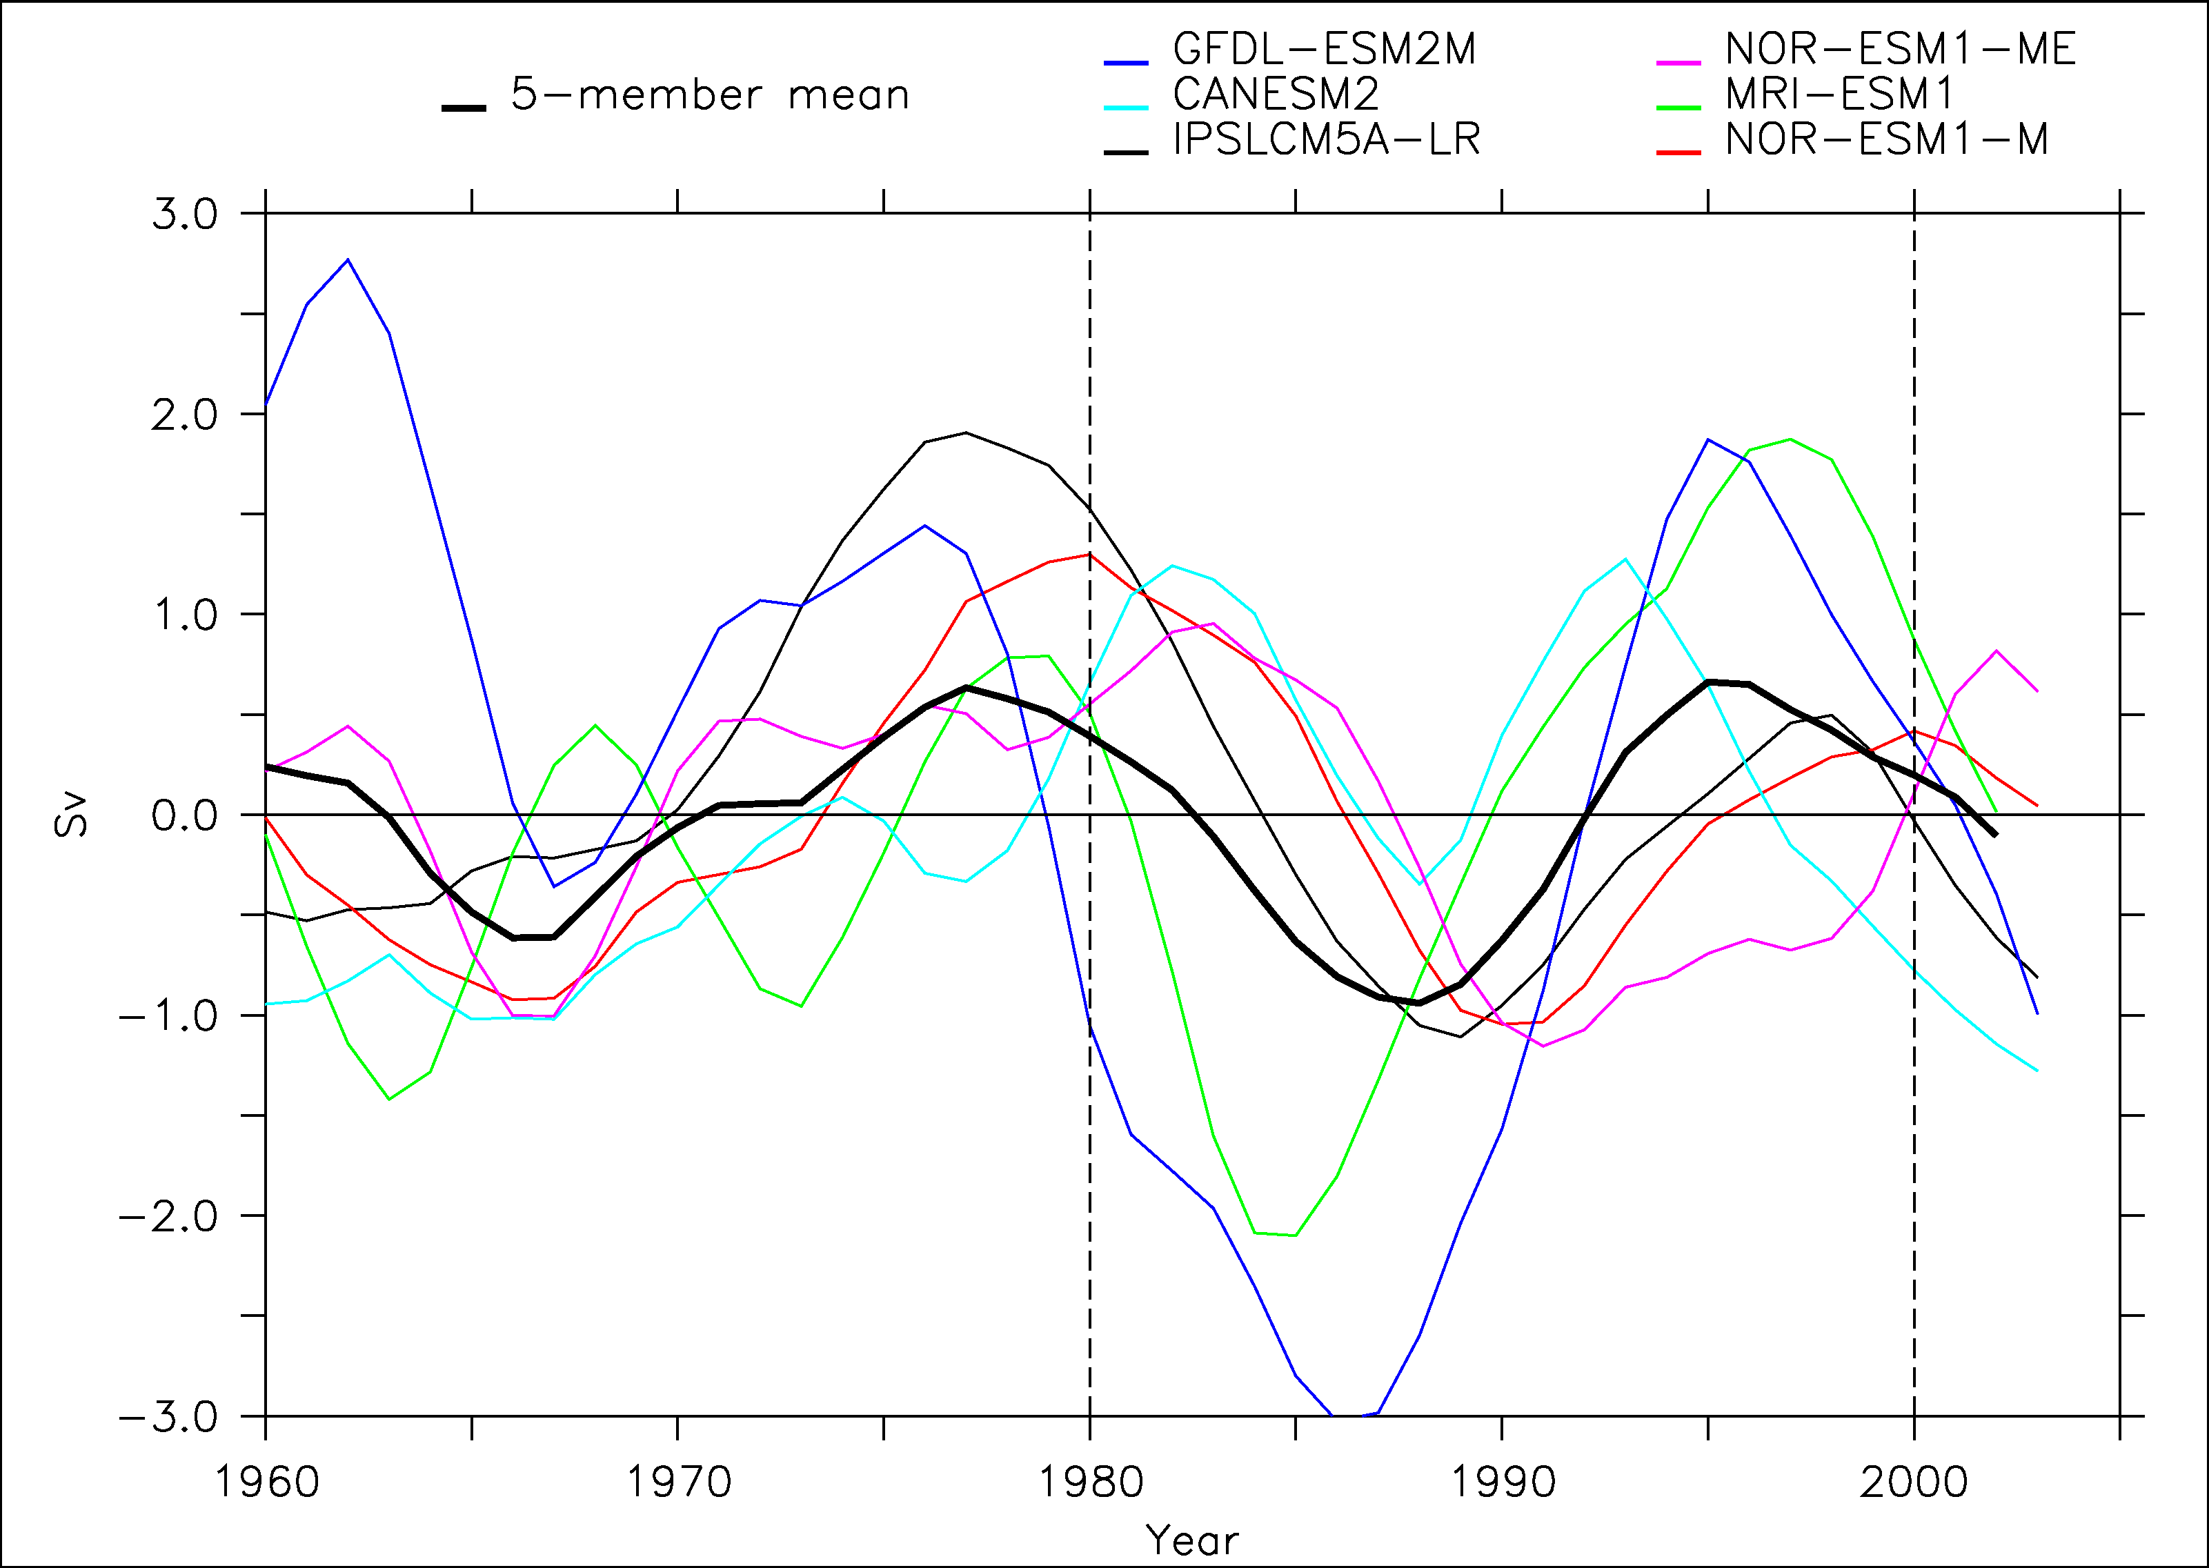
CMIP5 models

Slide 33
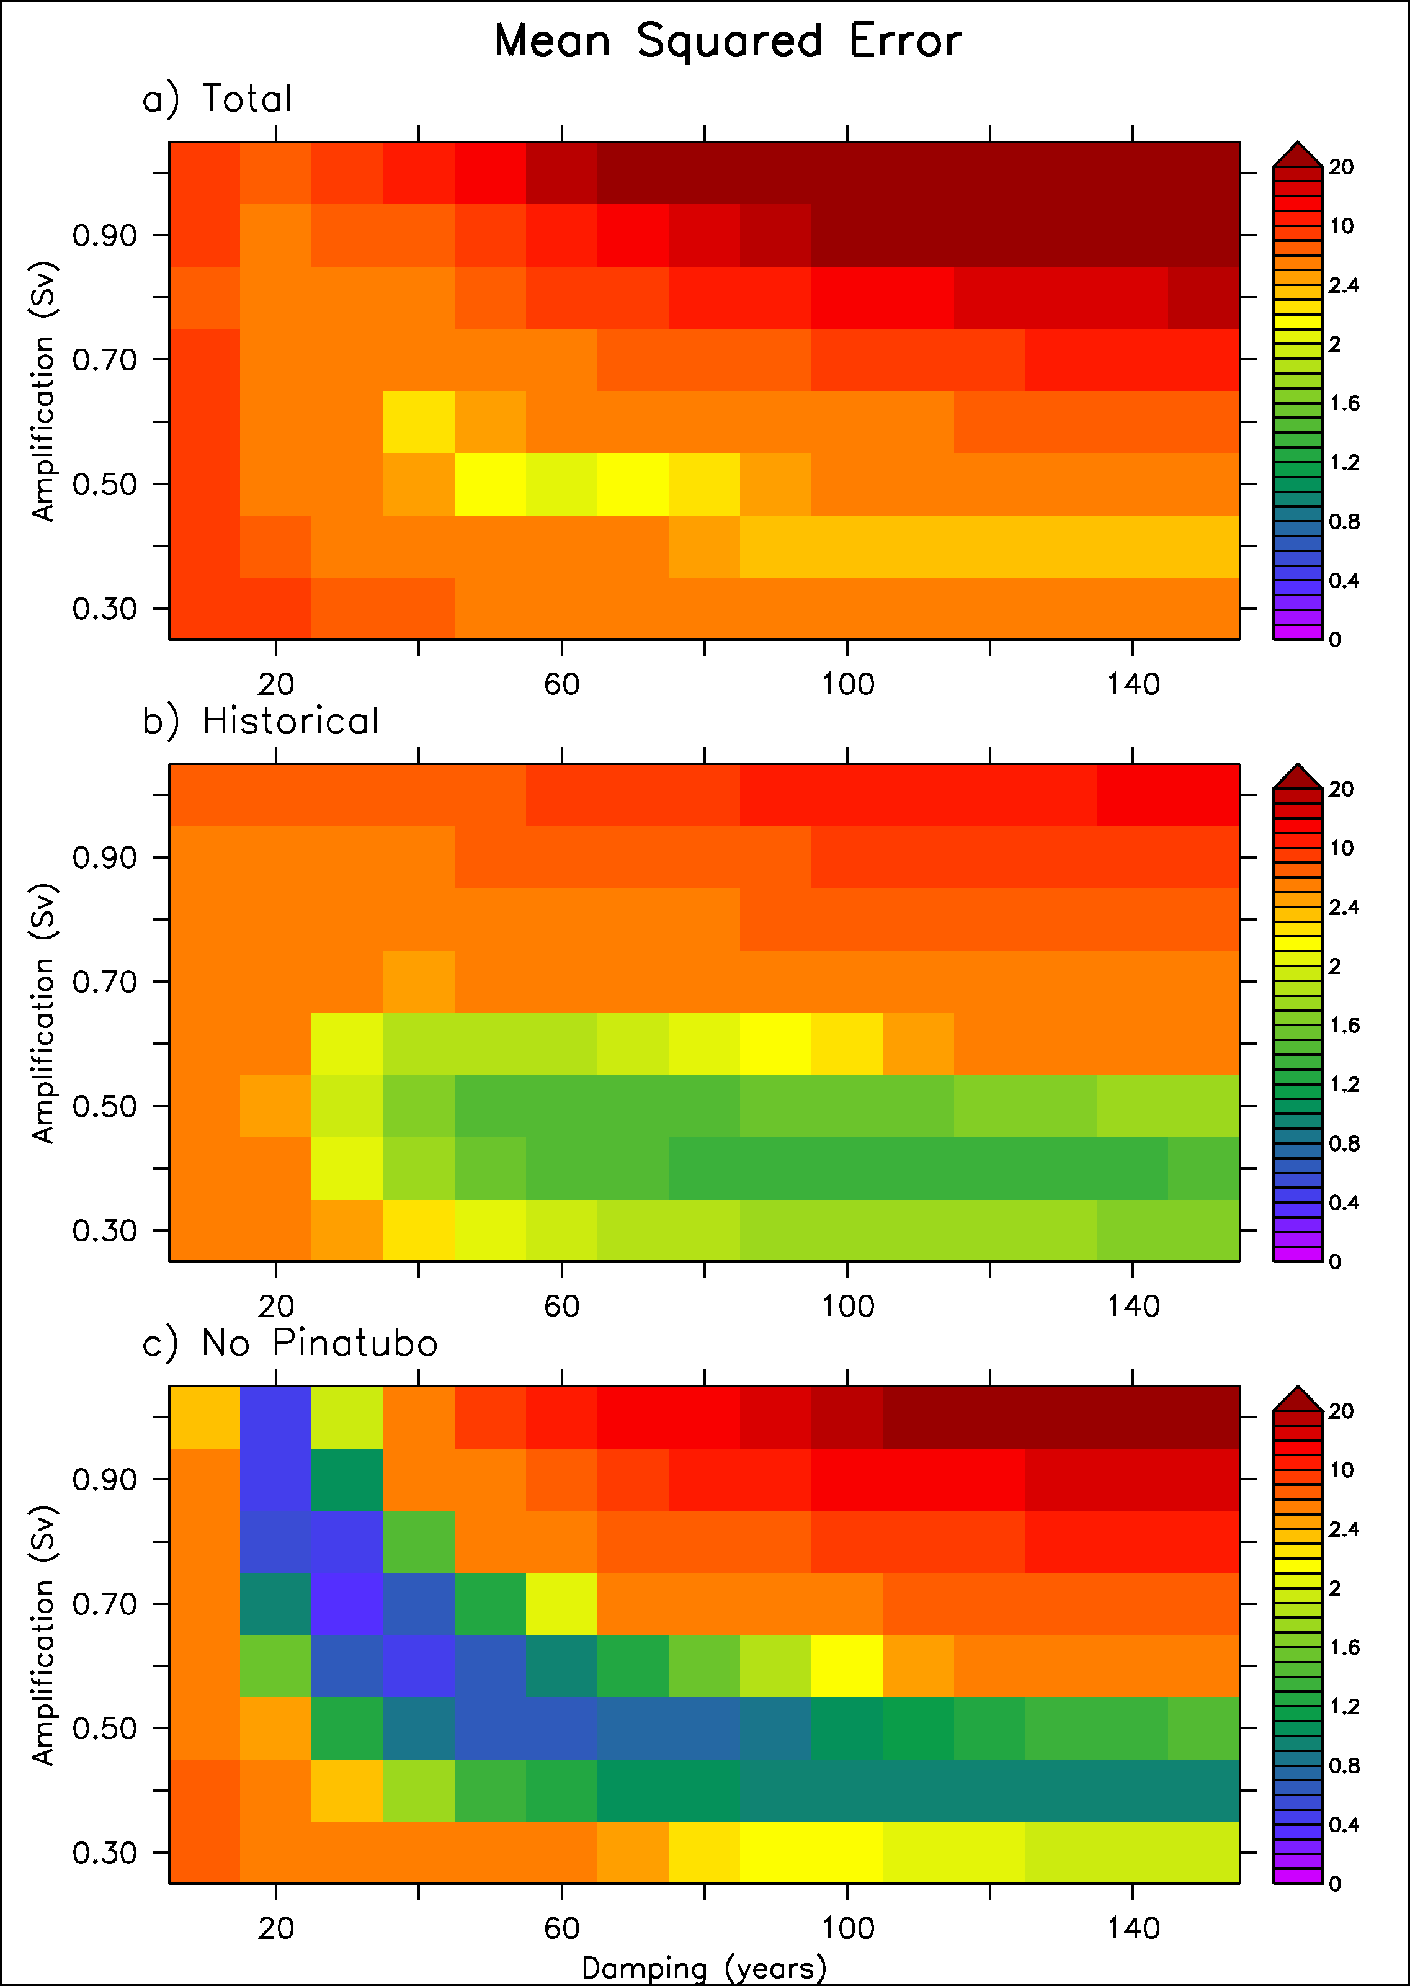
Scaling of the conceptual model
We use a cost function based on MSE between IPSL model and toy model

Slide 34
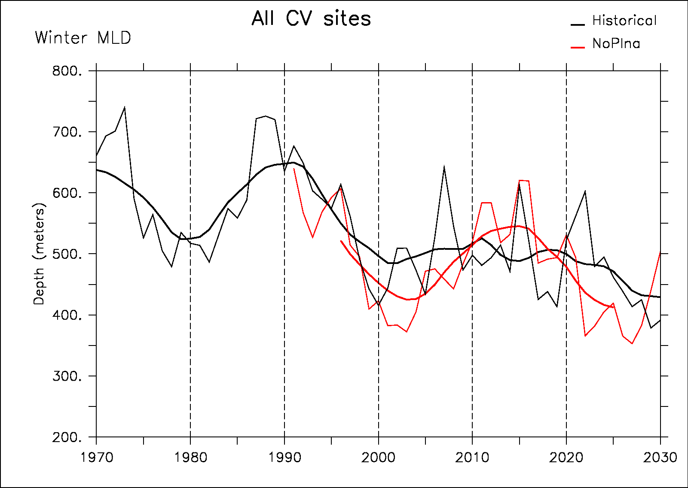




Convection sites response

Slide 35

Mechanisms
Historical
No Pinatubo
HadISST
Pinatubo decreases SST and increases sea-ice cover in the GIN Seas
This interferes with variability of the EGC
This removes the salinity anomalies in the Labrador Sea
And then the convection and the AMOC variations

Slide 36

In situ Labrador Sea variation
GSA
GSA
GSA
The 1985 GSA is clearly different from 1972 and 1993 in the sense that there is a subsurface positive anomaly
Belkin et al. (1998): two modes of GSA, one remote (Artic) and one more local (1980s)
Central Labrador Sea from 1949 to 2005 (updated from Yashayaev et al., 2003)
Source IPCC 2007

Slide 37

Temperature propagation

Slide 38

Comparison model-proxies
Pseudo-proxy approach: is there a link between nutrient and AMOC in the model?
AMOC leads nutirent supply with 1-3 years

